Slide 1
Physical Cosmology
Wolfgang Hillebrandt
MPI für Astrophysik
Garching
Lecture, TU Munich
WS 2011/12

Slide 2
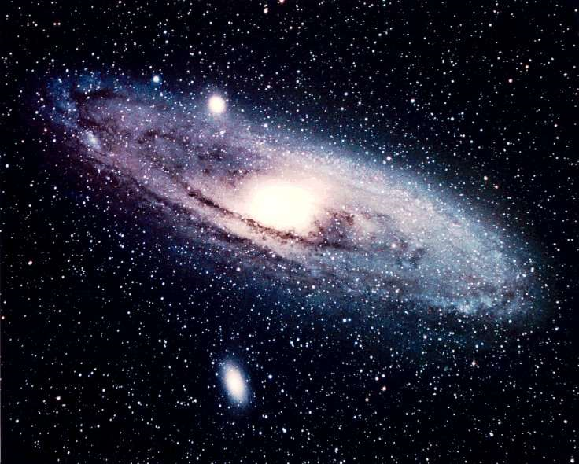

Slide 3
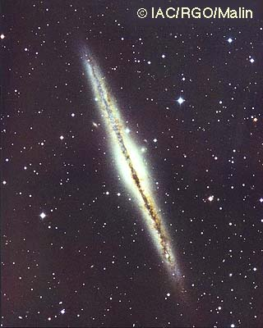
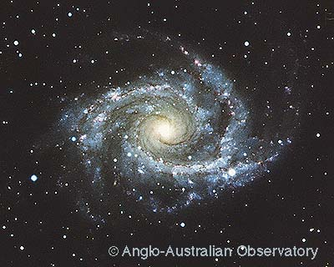
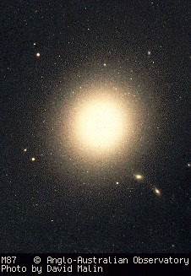
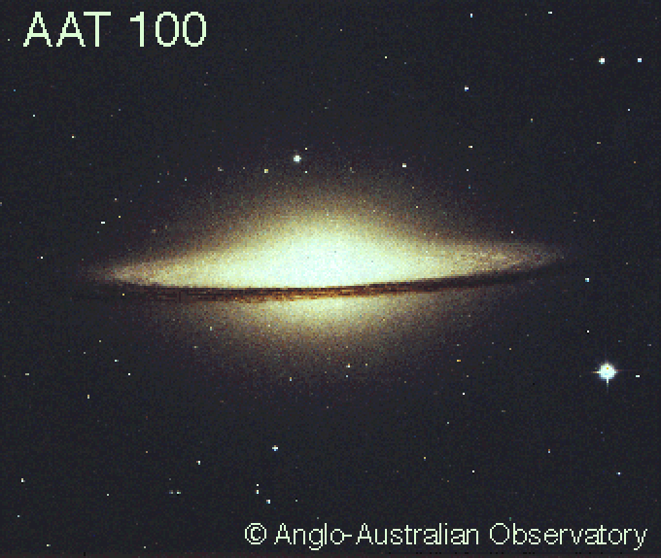
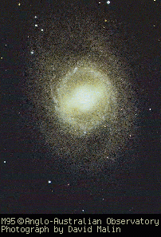
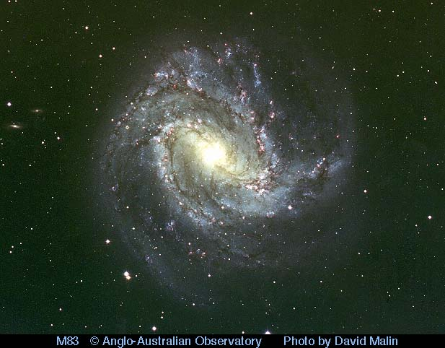
The Hubble sequence of galaxies

Slide 4
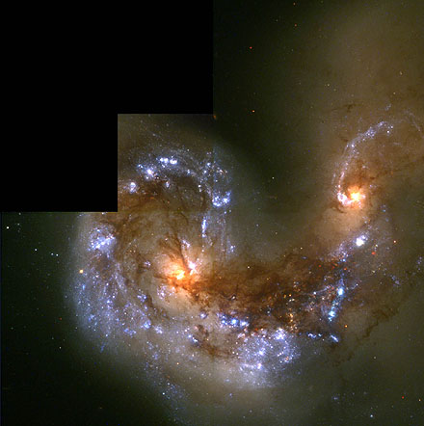
Do ellipticals form by merging spirals ?

Slide 5
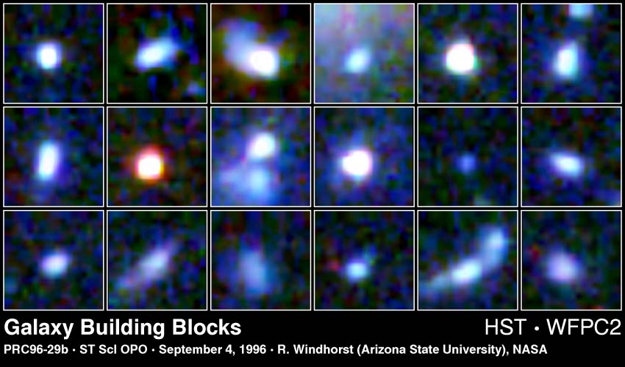
Younger galaxies should be smaller ...

Slide 6
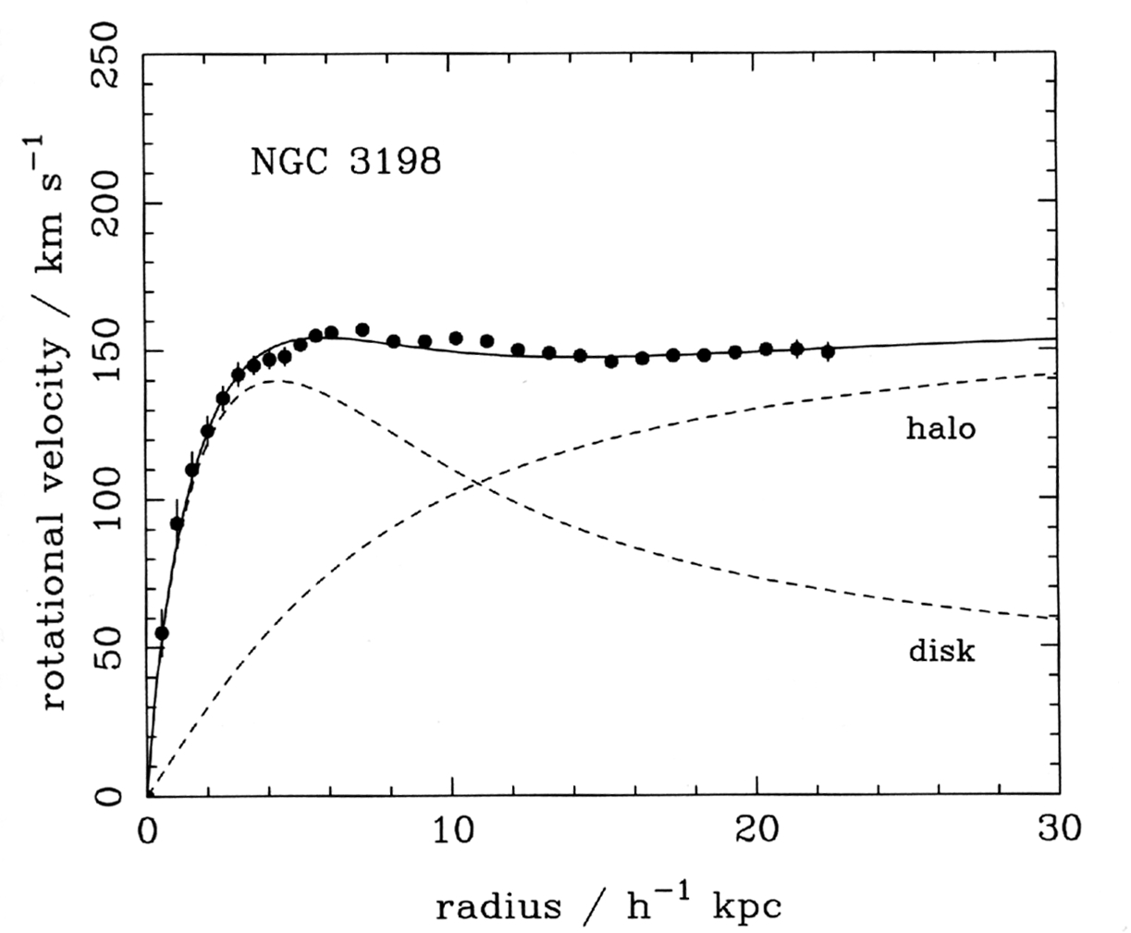
Evidence of dark matter: Rotation curves of galaxies
Outside a “point mass”:
V ~ R^{-1/2} !
(van Albada, 1995)

Slide 7
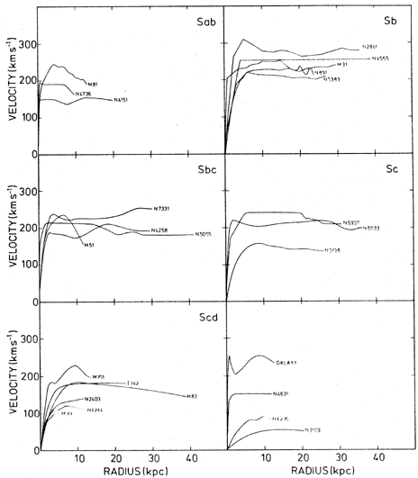
Rotation curves of galaxies

Slide 8
How can we see MACHOs ?
Gravitational lensing:
If foreground object has only little mass, the image split is too small to be observed
But the amplification (brightening) is observable

Slide 9
Example for light bending
“Einstein Cross” - G2237+0305

Slide 10
How can we see MACHOs ?
How likely is it for a star in the Milky Way to get amplified ?
Once every 10 million years !!!

Slide 11
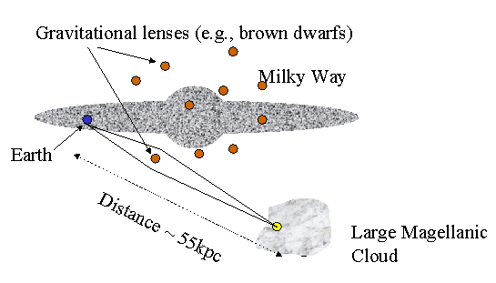
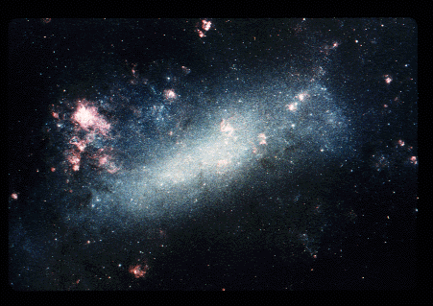
How did this work ?
Monitor 10 million stars simultaneously !

Slide 12
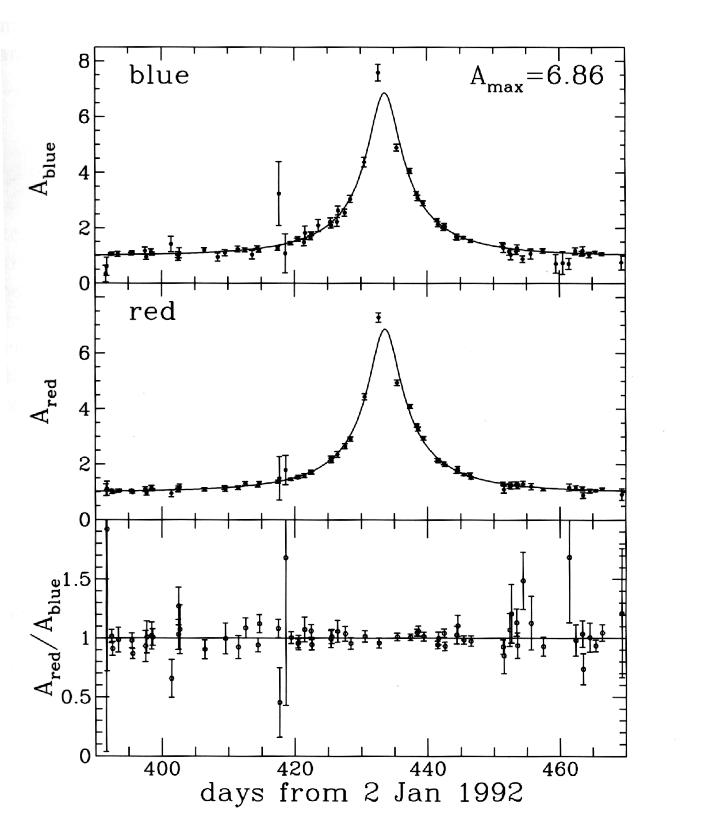
Light curve of a MACHO event
Achromatic (!) magnification due to gravitational lensing
There seem to be not enough brown dwarfs (or dark objects of similar mass) to account for the dark matter in the Milky Way !

Slide 13
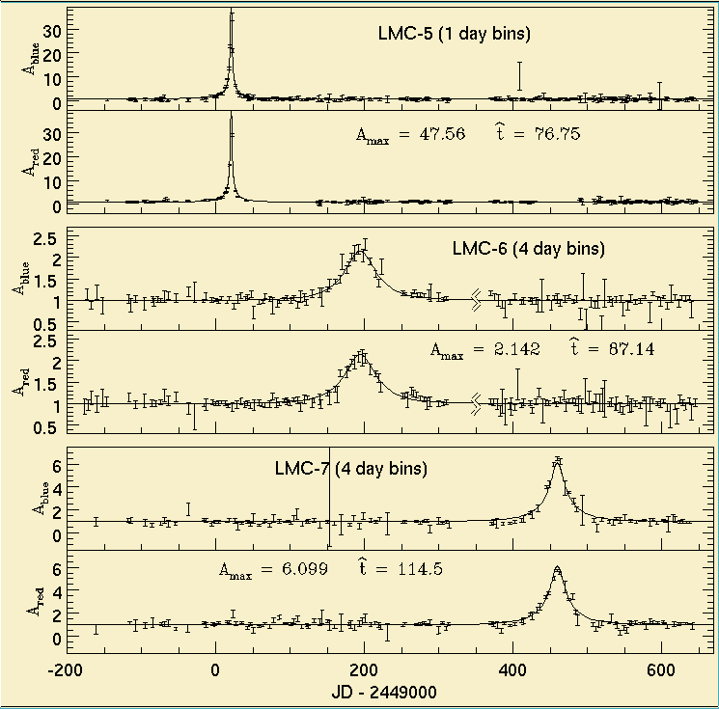
Other MACHO candidates

Slide 14
An OGLE MACHO candidate

Slide 15
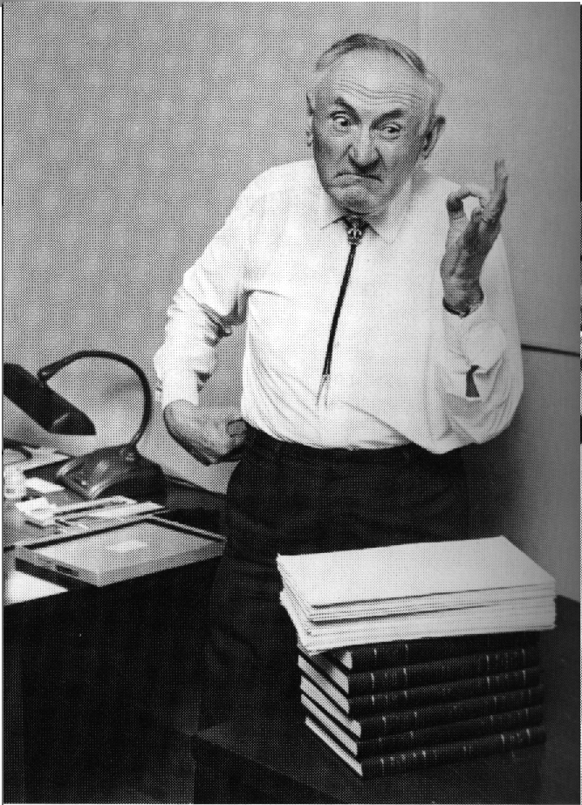
Fritz Zwicky
He measured the velocities of galaxies in galaxy clusters and concluded that most of the cluster’s mass must be dark.

Slide 16
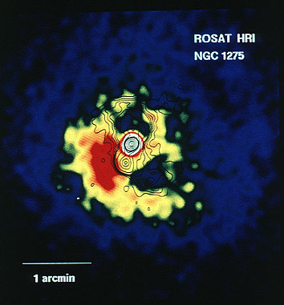
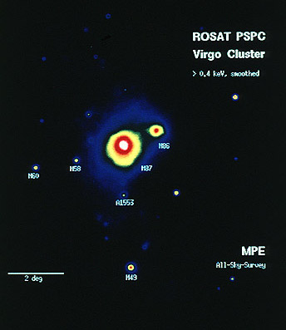
More evidence of dark matter: “X-ray clusters”

Slide 17
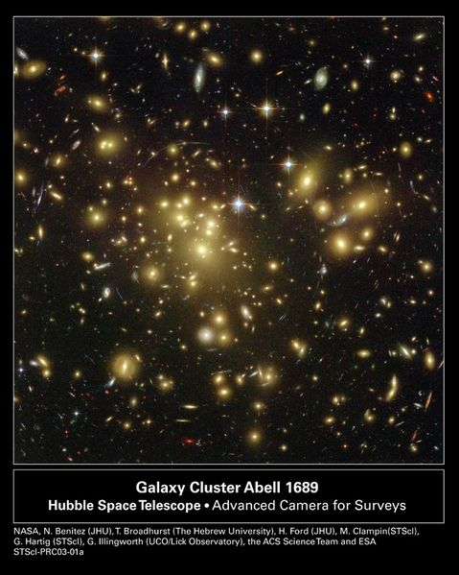
More evidence of dark matter: Galaxy clusters

Slide 18
Overall result:
Implications:
Most of the mass in the Universe is dark
Most of it is even of non-baryonic origin
The perfect Copernican principle
The Earth is not at the center of the solar system
The Sun is not at the center of the Milky Way
The Milky Way is not at the center of the Universe
We may not even be made from the most abundant type of matter in the Universe

Slide 19
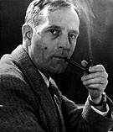
Edwin Hubble (1889-1953)
Four major accomplishments
in extragalactic astronomy:
The establishment of the Hubble classification scheme of galaxies
The convincing proof that galaxies are island “universes”
The distribution of galaxies in space
The discovery that the universe is expanding

Slide 20
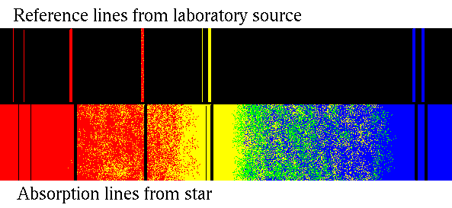
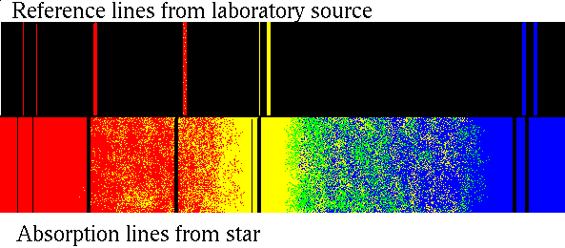
Doppler effect
The light of an approaching source is shifted to the blue,
the light of a receding source is shifted to the red.
blue shift
red shift

Slide 21
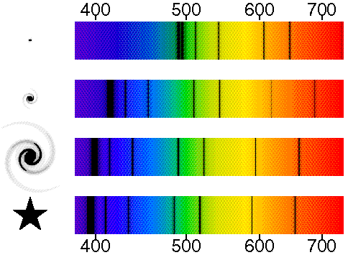
Doppler effect
redshift:
z=0: not moving
z=2: v=0.8c
z=∞: v=c

Slide 22
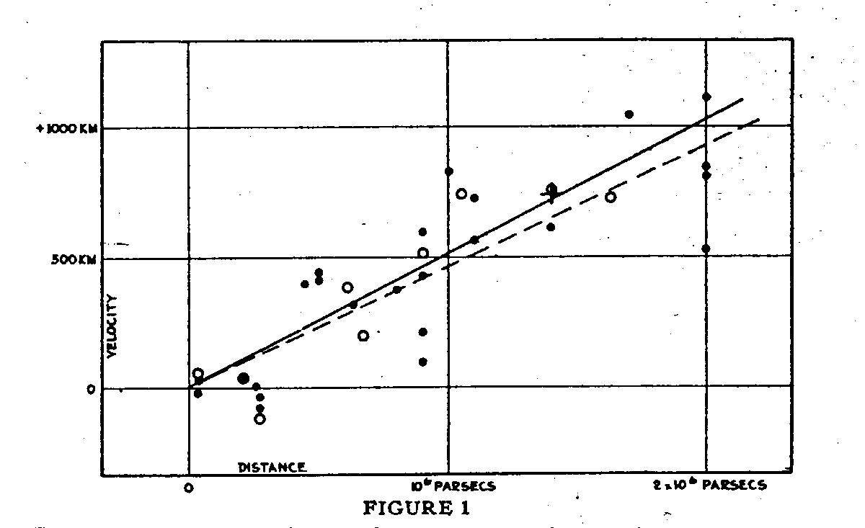
The redshift-distance relation

Slide 23
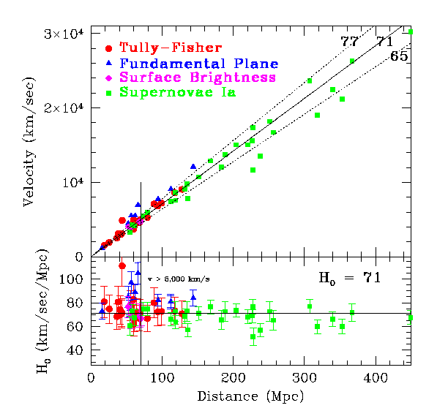
A “modern” Hubble diagram

Slide 24
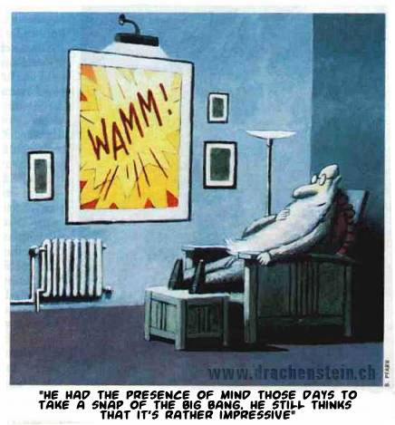

Slide 25
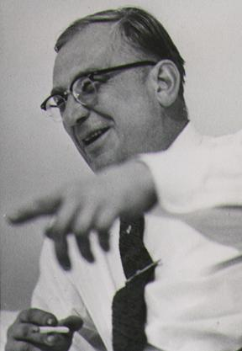
Georgy Gamov (1904-1968)
If the universe is expanding, then there has been a big bang
Therefore, the early universe must have been very dense and hot
Optimum environment to breed the elements by nuclear fusion (Alpher, Bethe & Gamow, 1948)
success: predicted that helium abundance is 25%
failure: could not reproduce elements more massive than lithium and beryllium (⇒ formed in stars)

Slide 27
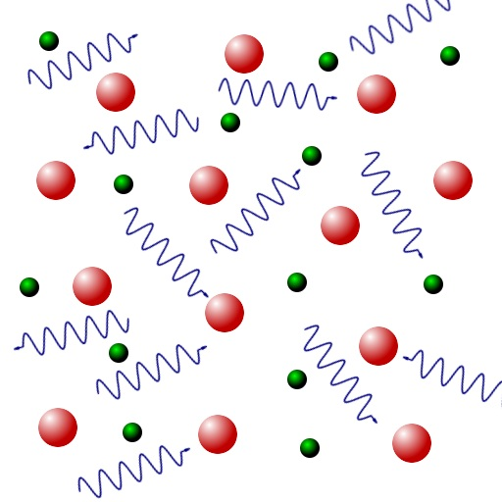
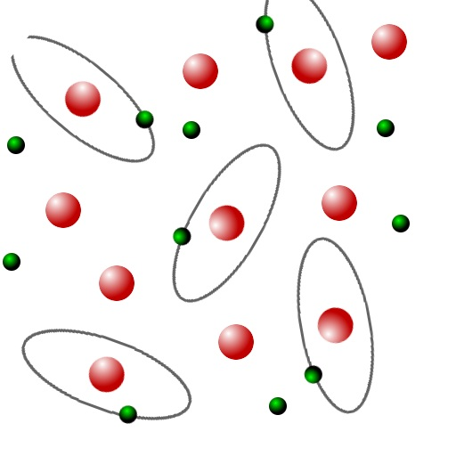
Before recombination: The Universe is opaque
After recombination: The Universe is transparent
Transition ~ 300 000 years after the Big Bang

Slide 28
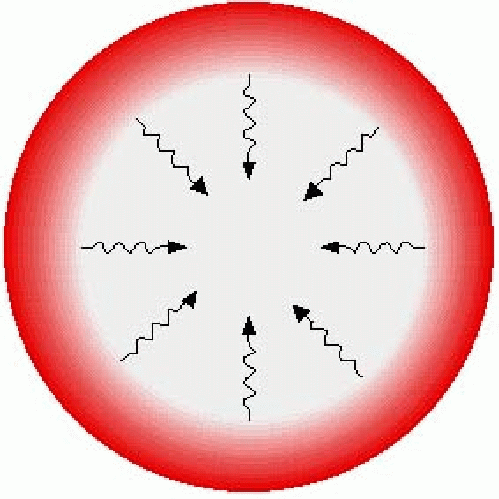
Last scattering surface
transparent
opaque

Slide 29
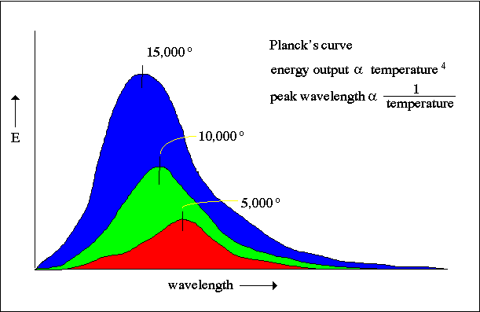
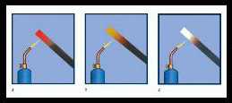
Black body radiation
A hot body is brighter than a cool one (L∝T⁴, Stefan-Boltzmann’s law)
A hot body’s spectrum is bluer than that of a cool one (λ_{max}∝1/T, Wien’s law)

Slide 30
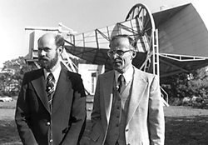
Penzias and Wilson 1965
Working at Bell labs
Used a satellite dish to measure radio emission of the Milky Way
They found some extra noise in the receiver, but couldn’t explain it ⇒ discovery of the background radiation
Most significant cosmological observation since Hubble
Nobel prize for physics 1978

Slide 31
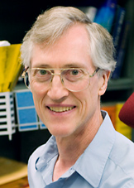
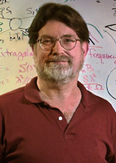
Nobel Price in Physics 2006 for COBE:
John Mather
George Smoot

Slide 32
Results from WMAP

Slide 33
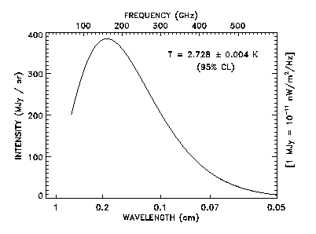
The cosmic microwave background radiation (CMB)
Temperature of 2.728±0.004 K
Isotropic to 1 part in 100 000
Perfect black body
1990ies: CMB is one of the major tools to study cosmology
Note: ~1% of the noise in your TV is from the big bang

Slide 34
How good is the assumption of isotropy?
CMB: almost perfect
But what about the closer neighbor-hood ?

Slide 35
How good is the assumption of isotropy?
CMB: almost perfect
But what about the closer neighbor-hood ?
The “great wall”

Slide 36
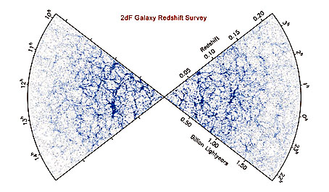
The spatial distribution of galaxies
Galaxies are not randomly distributed but correlated
Network of structures (filaments, sheets, walls) ⇒ “cosmic web”

Slide 37
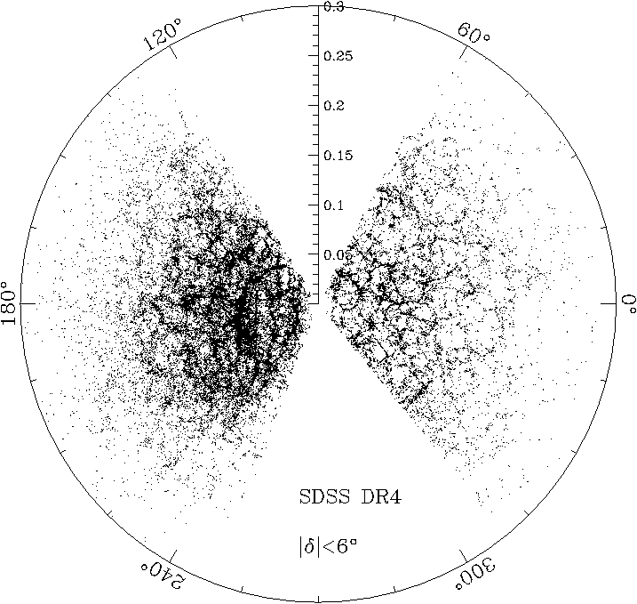
The spatial distribution of galaxies
Data from the most recent survey:
SDSS

Slide 38
The entire Universe in one line
Geometry of
spacetime
(Einstein tensor)
Distribution of
mass and energy
in the universe
(stress-energy tensor)

Slide 39
Some effects predicted by the theory of general relativity
Gravity bends light
Gravitational redshift
Gravitational time dilation
Gravitational length contraction

Slide 40
The cosmological principle
Homogeneous: the universe looks the same everywhere on large scales ⇒ there is no special place (center)
Isotropic: the universe looks the same in all directions on the sky
⇒ there is no special direction (axis)

Slide 41
The perfect cosmological principle
Homogeneous: the universe looks the same everywhere on large scales ⇒ there is no special place (center)
Isotropic: the universe looks the same in all directions on the sky ⇒ there is no special direction (axis)
Unchanging: The universe looks the same at all times ⇒ there is no special epoch

Slide 42
Homogeneity and Isotropy
Copernican
Principle
Isotropy
+
⇒
Homogeneity
Isotropy around another point
Isotropy
+
⇒
Homogeneity

Slide 43
A metric of an expanding Universe
Recall: flat space
better: using spherical coordinates (r,θ,φ)

Slide 44
A metric of an expanding Universe
But, this was for a static (flat) space. How does this expression change if we consider an expanding space ?
a(t) is the so-called scale factor

Slide 45
A metric of an expanding Universe
Robertson-Walker metric
a(t) is the scale factor
k is the curvature constant
k=0: flat space
k>0: spherical geometry
k<0: hyperbolic geometry

Slide 46
A metric of an expanding Universe
But, so far, we only considered a flat space. What, if there is curvature ?
k is the curvature constant
k=0: flat space
k>0: spherical geometry
k<0: hyperbolic geometry
k>0
k=0
k<0

Slide 47
Euclidean (flat) geometry:
Given a line and a point not on the line, only one line can be drawn through that point that will be parallel to the first line
The circumference of a circle of radius r is 2π r
The three angles of a triangle sum up to 180°

Slide 48
Spherical geometry:
Given a line and a point not on the line, no line can be drawn through that point that will be parallel to the first line
The circumference of a circle of radius r is smaller than 2π r
The three angles of a triangle sum up to more than 180°

Slide 49
Hyperbolic geometry:
Given a line and a point not on the line, an infinite number of lines can be drawn through that point that will be parallel to the first line
The circumference of a circle of radius r is larger than 2π r
The three angles of a triangle sum up to less than 180°

Slide 50
Can we calculate a(t) ?
Hubble Radius
distant galaxy
F_{outside}= 0

Slide 51
Can we calculate a(t) ?

Slide 52
What is the future of that galaxy ?
Critical velocity: escape speed
v<v_{esc}: galaxy eventually stops and falls back
v>v_{esc}: galaxy will move away forever

Slide 53
Let’s rewrite that a bit ...
ε∞<0 ⇒ v<v_{esc}: galaxy eventually stops and falls back
ε∞>0 ⇒ v>v_{esc}: galaxy will move away forever

Slide 54
Let’s rewrite that a bit ...
Homogeneous sphere of density ρ :
so for the velocity:
but what is ε∞ ?

Slide 55
Let’s switch to general relativity
Friedmann equation
same k as in the Robertson-Walker metric

Slide 56
Let’s switch to general relativity
Friedmann equation
k is the curvature constant
k=0: flat space, forever expanding
k>0: spherical geometry, eventually recollapsing
k<0: hyperbolic geometry, forever expanding

Slide 57
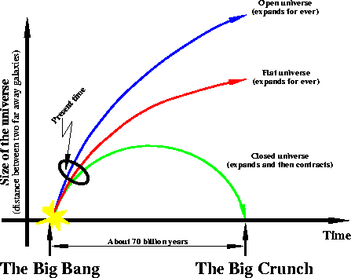
k>0
k=0
k<0

Slide 58
Cosmological redshift
While a photon travels from a distance source to an observer on Earth, the Universe expands in size from a_{then} to a_{now}.
Not only the Universe itself expands, but also the wavelength of the photon λ.

Slide 59
Cosmological redshift
General definition of redshift: ⇒ for cosmological redshift:

Slide 60
Cosmological redshift
Examples:
z=1 ⇒ a_{then}/a_{now} = 0.5
at z=1, the universe had 50% of its present day size
emitted blue light (400 nm) is shifted all the way through the optical spectrum and is received as red light (800 nm)
z=4 ⇒ a_{then}/a_{now} = 0.2
at z=4, the universe had 20% of its present day size
emitted blue light (400 nm) is shifted deep into the infrared and is received at 2000 nm
most distant astrophysical object discovered so far: Quasars (z≈6.4) and GRBs (z≈8.2)

Slide 61
(SDSS image; taken in October 2003)

Slide 62
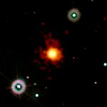
(Swift image; GRB 090423A)

Slide 63
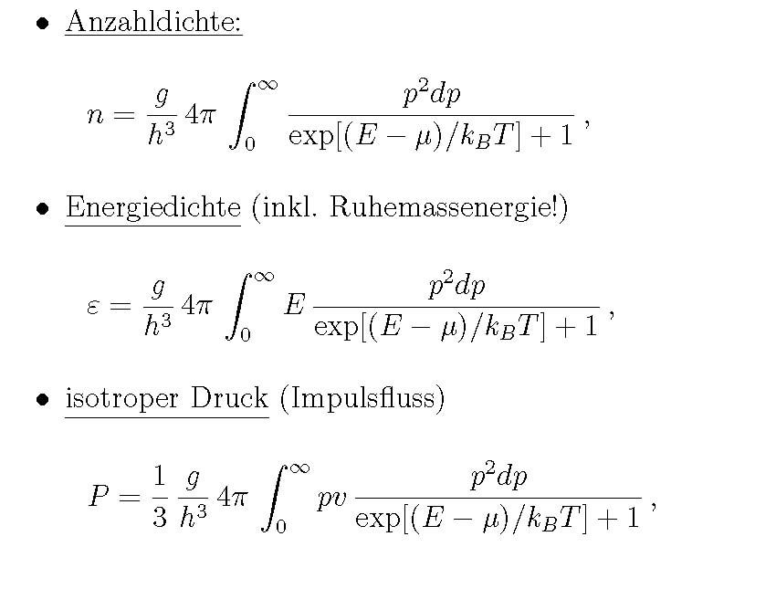
The equation of state of cosmic matter: Fermi gas

Slide 64
The equation of state of cosmic matter: general

Slide 65
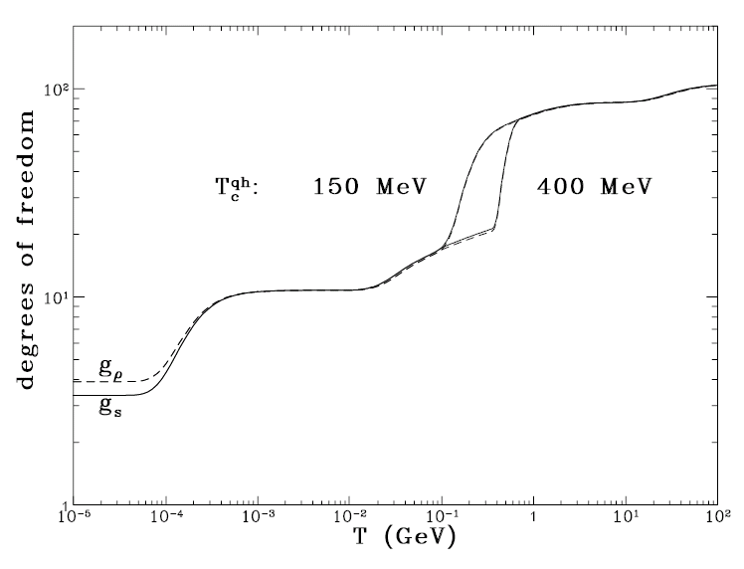
Relativistiv dgrees of freedom g_{eff}

Slide 66
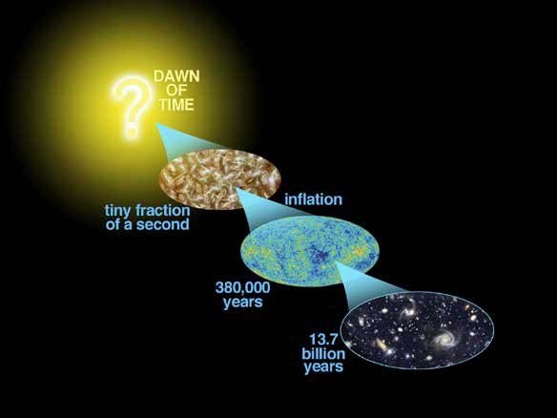

Slide 67
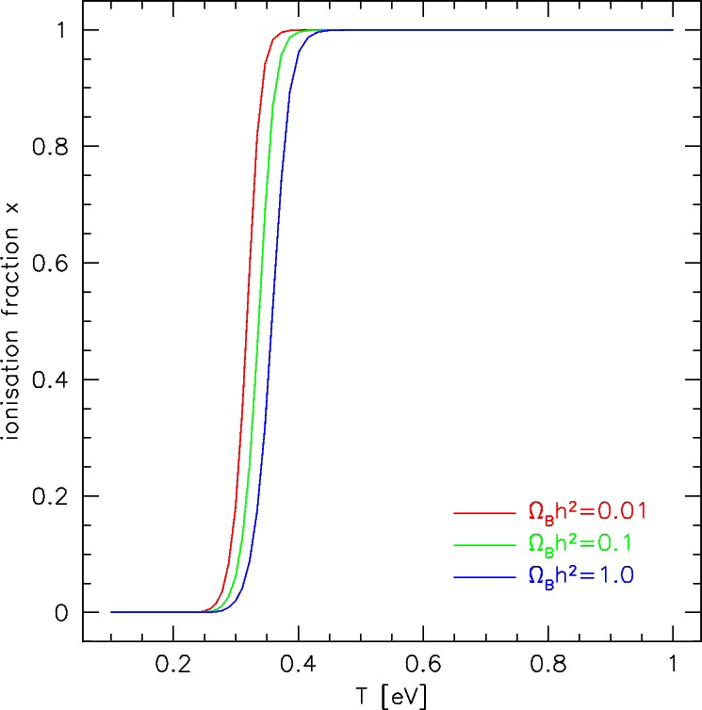
The physics of recombination: T_{recombination}

Slide 68
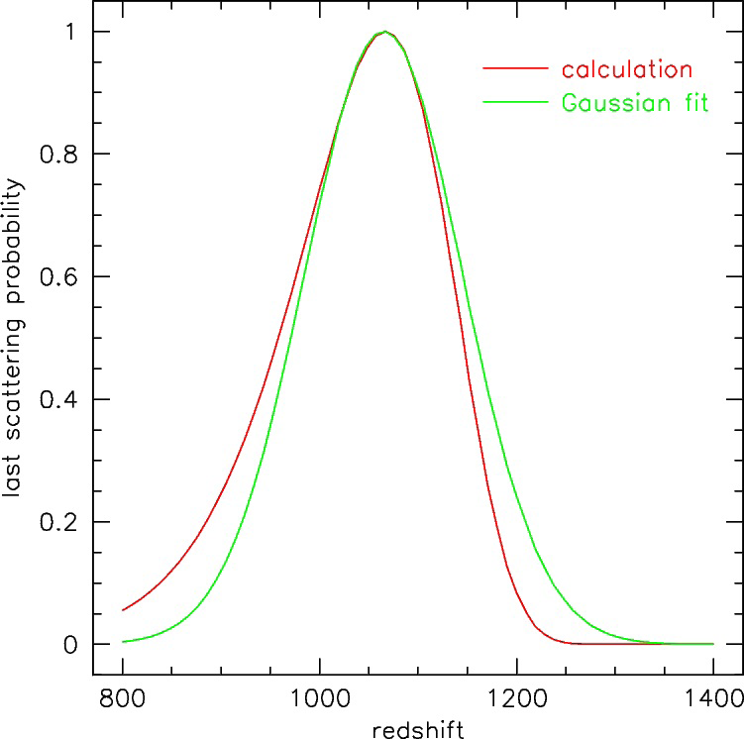
The physics of recombination: recombination shell

Slide 69
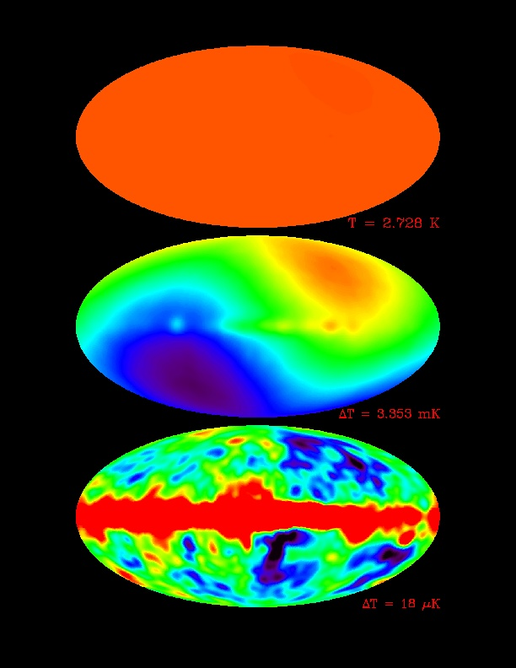
CMB: ‘foreground’ subtraction
ΔT=2.728 K
ΔT=3.353 mK
ΔT=18 μK
COBE maps

Slide 70
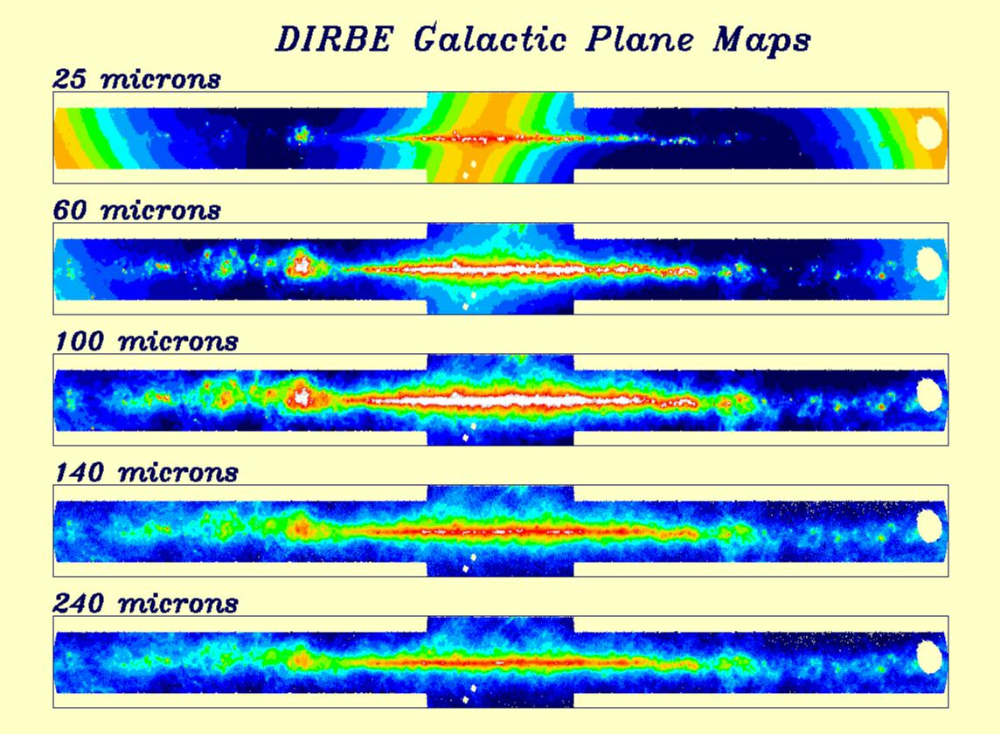
Milky Way contribution
COBE maps

Slide 71
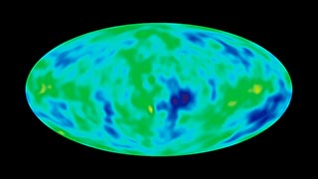
Final map
COBE maps

Slide 72
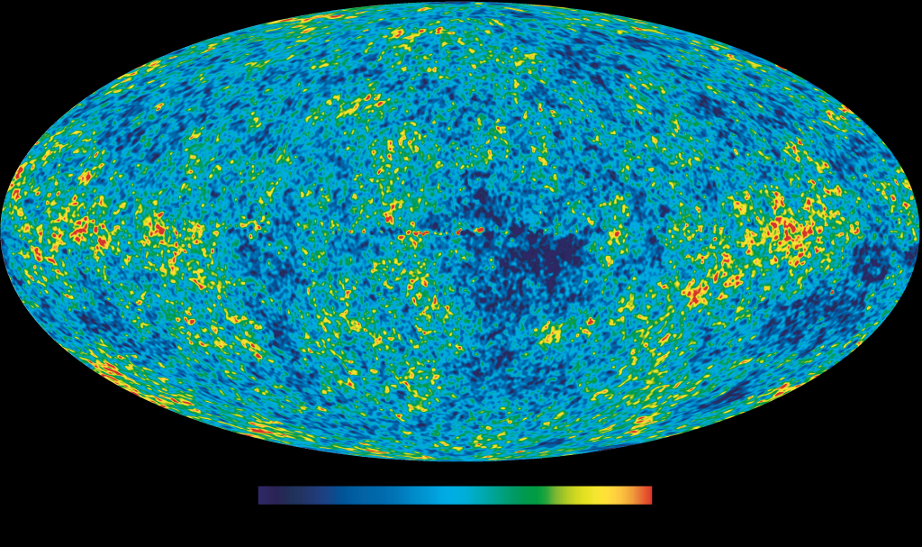
… and for WMAP:
-200 μK +200

Slide 73
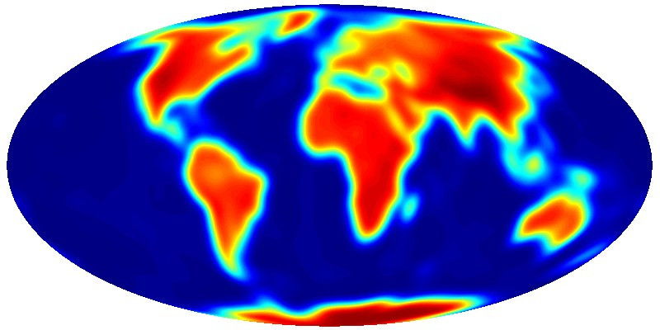
Progress over the years ……
COBE
~1990
WMAP
~2005

Slide 74
Where do the CMB fluctuations come from ?
Wrinkles: some regions have a slightly higher gravity, some a slightly lower (“potential wells”)
Matter falls into potential wells

Slide 75
Can we “see” the “sound” of the universe ?
Compressed gas heats up ⇒ temperature fluctuations

Slide 76
How can we measure the geometry of the universe ?
We need a yard stick on the CMB
For different curvatures, a yard stick of given length appears under different angles

Slide 77
Measuring the Curvature of the Universe Using the CMB
Result from Boomerang:
The Universe is flat to within 10%!

Slide 78
The CMB power spectrum and cosmological parameters

Slide 79
The CMB power spectrum from WMAP (1yr)

Slide 80
The CMB power spectrum from WMAP (3yr)

Slide 81
The CMB power spectrum from WMAP (5yr)

Slide 82
The CMB power spectrum from WMAP (7yr)

Slide 83
WMAP 5 years data
Komatsu et al. ; Astrophys. J. Subl. 180 (2009) 330

Slide 84
Planck Surveyor
Launch: May14, 2009

Slide 85
Planck Surveyor

Slide 86
Planck Surveyor

Slide 87
How can we determine the geometry and expansion rate of the Universe?
By measuring distances and/or angular diameters.

Slide 88
How do we measure distances in “daily life” ?
Parallaxes
Travel time
Via size of objects: comparison with standard yard sticks
Via brightness of objects: comparison with standard candles

Slide 89
Parallaxes
Measure the position of an object with respect to its background
Nearby objects show a larger “motion” than objects far away do
The parallax angle θ , the distance of the object D and the diameter of the Earth’s orbit d are connected by simple geometrical relations. For small angles, it is d = D × θ [units !!!! θ measured in rad !]

Slide 91
Travel time
If you know the speed v you’re traveling with and the travel time Δt, the distance D can be obtained by simple multiplication: D = v Δt
Astronomy: Use light travel times, i.e. v = 300 000 km/sec

Slide 92
Comparison with a standard ruler
An object nearby spans a larger angle than an object of identical physical size far away
The physical size l of the object, its distance D and the angle q under which it appears are connected by simple geometrical relations. For small angles, it is l = D × q [units !!!! q measured in rad !]
If the physical size l of an object is known (⇒ standard ruler), its distance D can be determined by measuring the angle q under which the object appears

Slide 93
Standard Candles
Cepheid and RR Lyrae variables
Pulsating stars which change in brightness with a characteristic period
Period is proportional to absolute luminosity
Common and bright (esp. Cepheids), thus visible in nearby galaxies
Good to ~20 Mpc

Slide 94
Luminosity distances (replaces 1/r² – law):
Where and
w_{M}= 0 (matter)
w_{R}= ⅓ (radiation)
w_{Λ}= -1 (cosmological constant/vacuum)

Slide 95
Calibrated “standard candles”

Slide 96
Calibrated “standard candles”
(e.g., δ-Cephei stars)

Slide 97
Distances with δ Cephei stars
Direct measurement of the change in angular diameter
plus spectroscopic radial velocity (Kervella et al. 2004)

Slide 98
Distances with δ Cephei stars
LMC Cepheids:
D = (51 ± 3)
kpc

Slide 99
Calibrated “standard candles”
(e.g., δ-Cephei stars)
D =
(17±2)
Mpc

Slide 100
Supernova classification

Slide 101
Supernova light curves
Patat et al. (2001)

Slide 102
Distances with Type Ia Supernovae
Use the Hubble diagram (m-M vs. log z)
m-M=5log(z)+25+5log(c)-5log(H₀)
Note that the slope is given here.
Hubble constant can be derived when the absolute luminosity M is known
logH₀=log(z)+5+log(c)-0.2(m-M)
Give relative distances only!

Slide 103
Hubble constant from SNe Ia
Calibrate the absolute luminosity
through Cepheids
‘classical distance ladder’
depends on the accuracy of the previous rungs on the ladder
LMC distance, P-L(-C) relation, metallicities
HST program (Sandage, Tammann)
HST Key Programme (Freedman, Kennicutt, Mould, Madore)
through models
extremely difficult (but possible!)

Slide 104
Absolute Magnitudes of SNe Ia
(Saha et al. 1999)

Slide 105
Nearby SNe Ia
Phillips et al. (1999)

Slide 106
Correlations between peak luminosity and LC shape
Phillips et al. 1999

Slide 107
Light curve shape – luminosity
(B-band light curves; Calan/Tololo sample, Kim et al. 1997)
After calibration: SNe Ia look like good “standard candles”!

Slide 108
Normalisation of the peak luminosity
Phillips et al. 1999
Using the luminosity-decline rate relation one can normalise the peak luminosity of SNe Ia
Reduces the scatter!

Slide 109
The nearby SN Ia sample
Evidence for good
distances
Notes:
The data have a nice gaussian error distribution of 0.16 mag (8%)

Slide 110
Hubble constant from SNe Ia
Extremely good (relative) distance indicators
distance accuracy better than 10%
Uncertainty in H₀ mostly from the LMC and the Cepheid P-L relation
Today’s best value (Cepheids + SNe Ia):
H₀ = (72 ± 6) km/s/Mpc
Note: This enters as an uncertainty in many other places!

Slide 111
Measuring the deceleration parameter q₀
How do we do that?
Measure the rate of expansion at different times, i.e. measure and compare the expansion based on nearby galaxies and based on high redshift galaxies or other objects, e.g., Type Ia supernovae.
Gravity is slowing down the expansion ⇒ expansion rate should be higher at high redshift.

Slide 112
Nobel Prize for Physics 2011....
Saul Perlmutter Brian Schmidt Adam Riess
“… for the discovery of the accelerating expansion of the Universe through observations of distant supernovae"

Slide 113
Distant supernovae
Supernovae are very rare, ~ 1 SN per 100 years and galaxy.
One has to observe very many galaxies!

Slide 114
Search strategy:
1. Repeated scanning of a certain field.
2. Electronic readout of the data.
3. Follow-up observations, e.g., HST, VLT, …

Slide 115
Supernovae are routinely detected at redshifts Z > 0.1:
What is the intrinsic scatter in luminosities?
Are they different from the local sample?
Do we understand the differences?

Slide 116
So let’s measure q₀ !
q₀ = 0
q₀ = 0.5
Data indicates:
q₀ < 0
⇒ Expansion
is accelerating
fainter
more distant

Slide 117
The fate of the Universe
Ω₀ = 0
Mean distance between galaxies
open
Ω₀ < 1
Ω₀ = 1
closed
Ω₀ > 1
fainter
Redshift
- 14
- 9
- 7
today
time
Billion years

Slide 118
Friedmann’s equation for Λ>0
k is the curvature constant
k=0: flat space
k>0: spherical geometry
k<0: hyperbolic geometry
but for sufficiently large Λ a spherically curved universe may expand forever
k is the curvature constant
k=0: flat space, flat universe
k>0: spherical geometry, closed universe
k<0: hyperbolic geometry, open universe

Slide 119
Most recent supernova data (January 2011) (557 SNe)
μ = m - M

Slide 120
The most recent Hubble diagram
Rodney et al. 2012

Slide 121
General luminosity distance
with and
w_{M}= 0 (matter)
w_{R}= ⅓ (radiation)
w_{Λ}= -1 (cosmological constant)

Slide 122
Cosmological parameters from different probes
Goobar & Leibundgut 2011

Slide 123
H(z) reconstruction from D_{L}
Benitez-Herrera et al. 2011

Slide 124
H(z) reconstruction from D_{L}

Slide 125
Georgy Gamov (1904-1968)
If the universe is expanding, then there has been a big bang
Therefore, the early universe must have been very dense and hot
Optimum environment to breed the elements by nuclear fusion (Alpher, Bethe & Gamow, 1948)
success: predicted that helium abundance is 25%
failure: could not reproduce elements more massive than lithium and beryllium (⇒ formed in stars)

Slide 126
Abundances of elements
Hydrogen and helium most abundant
gap around Li, Be, B

Slide 127
Transforming hydrogen into helium
Hot big bang: neutrons and protons
Use a multi step procedure:
– p + n → ²H
p + ²H → ³He
n + ²H → ³H
³He + ³He → ⁴He + 2 p
some side reactions:
⁴He + ³H → ⁷Li
⁴He + ³He → ⁷Be

Slide 128
Relevant nuclear reactions

Slide 129
Ratio of free neutrons to protons

Slide 130
Mass gap/stability gap at A=5 and 8
There is no stable atomic nucleus with 5 or with 8 nucleons
Reaction chain stops at ⁷Li
So how to form the more massive elements?
There exist a meta-stable nucleus (⁸B*). If this nucleus is hit by another ⁴He during its lifetime, ¹²C and other elements can be formed

Slide 131
Primordial nucleosynthesis

Slide 132
Primordial nucleosynthesis
Consistent with
abundance
of H, He and Li
Result:
abundances of H, He and Li are consistent
but: Ω_{b}(CMB) ~0.04 (too high!)

Slide 133
Primordial nucleosynthesis
But:
The Li problem!
CMB: Ω_{b} h² = 0.0225 ± 0.0006
Perfect agreement!

Slide 135
Problems of the ‘standard model’ 1. ‘Flatness’: Why is Ω close to 1?

Slide 136
Problems of the ‘standard model’ 1. ‘Flatness’: Why is Ω close to 1?
Δρ ≈ 10⁻²⁴!

Slide 137
Problems of the ‘standard model’ 2. ‘Horizon’: Why is the Universe so homogenous?

Slide 138
Problems of the ‘standard model’ 2. ‘Horizon’: Why is the Universe so homogenous?

Slide 139
Solution: Inflation?

Slide 140
Inflation and the horizon problem

Slide 141
Inflation and the horizon problem

Slide 142
Inflation and the flatness problem

Slide 143
Models for Inflation Basic idea (Guth, Sato, Linde, …, 1981, 1982):
V_{eff} = V(Φ) + T⁴f(Φ/T); Φ: scalar field; f→0 if Φ→0
σ

Slide 144
Models for Inflation ‘Old’ vs ‘new’ inflation (Albrecht & Steinhardt 1982):
Inflaton field

Slide 145
General acceptance of the big bang model
Until mid 60ies: big bang model very controversial, many alternative models
After mid 60ies: little doubt on validity of the big bang model
Four pillars on which the big bang theory is resting:
Hubble’s law ✓
Cosmic microwave background radiation ✓
The origin of the elements ✓
Structure formation in the universe ←

Slide 146
Structure formation in the Big-Bang model

Slide 147
A galaxy census: spiral galaxies
Most common type among the luminous galaxies (~75%)
Two major classes, S and SB
regular spirals (S)
barred spirals (SB)
Further classified from a to d according to the bulge-to-disk ratio
a: very large, prominent bulge
d: essentially no bulge at all
The Milky Way is a Sbc or a SBbc galaxy

Slide 148
A galaxy census: spiral galaxies
Spiral galaxies are disk like and in centrifugal equilibrium
The are “cold”, i.e. the velocity dispersion (random motion of individual stars) σ is much smaller than the rotation velocity v_{rot} (Milky Way: σ=20 km/s; v_{rot}=220 km/s)
They mainly consist of stars, but ~10% of the mass is gas and dust
They actively form stars (Milky Way: ~ 1 star per year)

Slide 149
A galaxy census: elliptical galaxies
~20% of the luminous galaxies are ellipticals
Classified according to the flattening E0-E7: n=10×(1-b/a)
E0: circular
E7: minor axis only 30% of major axis
They are ‘hot’, i.e. the velocity dispersion σ is much larger than the rotation velocity v_{rot}
Flattened by an anisotropic velocity dispersion
Little gas, no recent star formation
Predominantly in clusters of galaxies

Slide 150
A galaxy census: other galaxies
Irregular galaxies (~ 5% of the luminous galaxies)
Dwarf galaxies
dwarf irregulars
dwarf spheroidals
dwarf ellipticals
blue compact dwarfs
...

Slide 151
Toomre & Toomre (mid 70s)
11 out of the 4000 galaxies in the New General Catalog (NGC) show indications of recent interactions (e.g. tails)
Those tidal features last a few 10⁸ years
Over the age of the universe, several hundred of those interactions must have taken place
There are several hundred elliptical galaxies in the NGC

Slide 152
Do ellipticals form by merging spirals ?

Slide 153
How does structure form ?
Wrinkles in the CMB: regions of higher and lower temperature
Those regions correspond to density fluctuations, regions of slightly higher/lower density than average
Gravitational instability
higher density ⇒ more mass in a given volume
more mass ⇒ stronger gravitational attraction
stronger gravitational attraction ⇒ mass is pulled in ⇒ even higher density

Slide 154
z=9.00
65 Mpc
50 million particle N-body simulation

Slide 155
z=4.00
65 Mpc
50 million particle N-body simulation

Slide 156
z=2.33
65 Mpc
50 million particle N-body simulation

Slide 157
z=1.00
65 Mpc
50 million particle N-body simulation

Slide 158
z=0.00
65 Mpc
50 million particle N-body simulation

Slide 159
Recent simulations (MPA group)
(Court. V. Springel)

Slide 160
Density fluctuations and relevant scales
SDSS collaboration

Slide 161
Jeans length and mass: dark matter

Slide 162
Jeans length and mass: dark matter

Slide 163
Jeans length and mass: baryonic matter

Slide 164
Jeans length and mass: baryonic matter

Slide 165
Can astronomy help to discriminate between neutrinos and neutralinos ?
Neutrinos: Hot Dark Matter (HDM)
mass in the tens of eV ⇒ very low mass
very low mass ⇒ high velocities ⇒ “hot”
can travel several tens of Mpc over the age of the universe
Neutralinos: Cold Dark Matter (CDM)
mass in the hundredst of GeV ⇒ very high mass
very high mass ⇒ low velocities ⇒ “cold”
cannot travel significant distances over the age of the universe

Slide 166
Can astronomy help to discriminate between hot and cold dark matter ?
CDM
HDM

Slide 167
Structure formation: HDM vs CDM
Hot dark matter:
initial small scale structure (anything smaller than a galaxy cluster) washed out due to the high velocities of neutrinos
clusters and supercluster form first
galaxies form due to fragmentation of collapsing clusters and superclusters
top-down structure formation

Slide 168
Structure formation: HDM vs CDM
Cold dark matter:
plenty of small scale structure
small galaxies form first, clusters last
larger structures form due to merging of smaller structures
bottom-up or hierarchical structure formation

Slide 169
Structure formation: HDM vs CDM
CDM fits observations much better than HDM
high-z galaxies are smaller
irregular shape of galaxy clusters indicate that they formed recently
there are only a very few clusters at high redshift, but many galaxies
two-point correlation function is much better reproduced

Slide 170
Recent simulations (MPA group)
(Court. V. Springel)

Slide 171
A voyage through a CDM universe
© M. Steinmetz

Slide 172
A galaxy formation recipe
Ingredients: gas, radiation, gravity
Pick a model for the Universe
Add some seeds (perturbations) to trigger growth of structure
Combine it with some recipe of your star formation cookbook

Slide 173
(Courtesy: M. Steinmetz)

Slide 174
(Courtesy: M. Steinmetz)

Slide 175
(Court. V. Springel)

Slide 176
Hierarchical galaxy formation

Slide 178
Phase I: Formation of First Galactic Disks (1Gyr)
first relaxed small disks

Slide 179
Phase II: Bulge Formation and Disk Reassembly (2 Gyr)
Disks are destroyed by merging, formation of an elliptical
Later on: disk reassemble

Slide 180
Phase III: Well Developed Disk+Bulge Structure (3 Gyr)
slowly growing disk
young stars and gas in thin disk, bulge of old stars

Slide 181
Phase IV: Tidally Triggered Bar Formation (5 Gyr)
several minor mergers
rapidly rotating bar

Slide 182
Phase V: Formation of a Giant Elliptical (7 Gyr)
nuclear star burst consumes nearly all remaining gas

