Slide 1
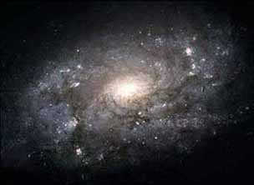

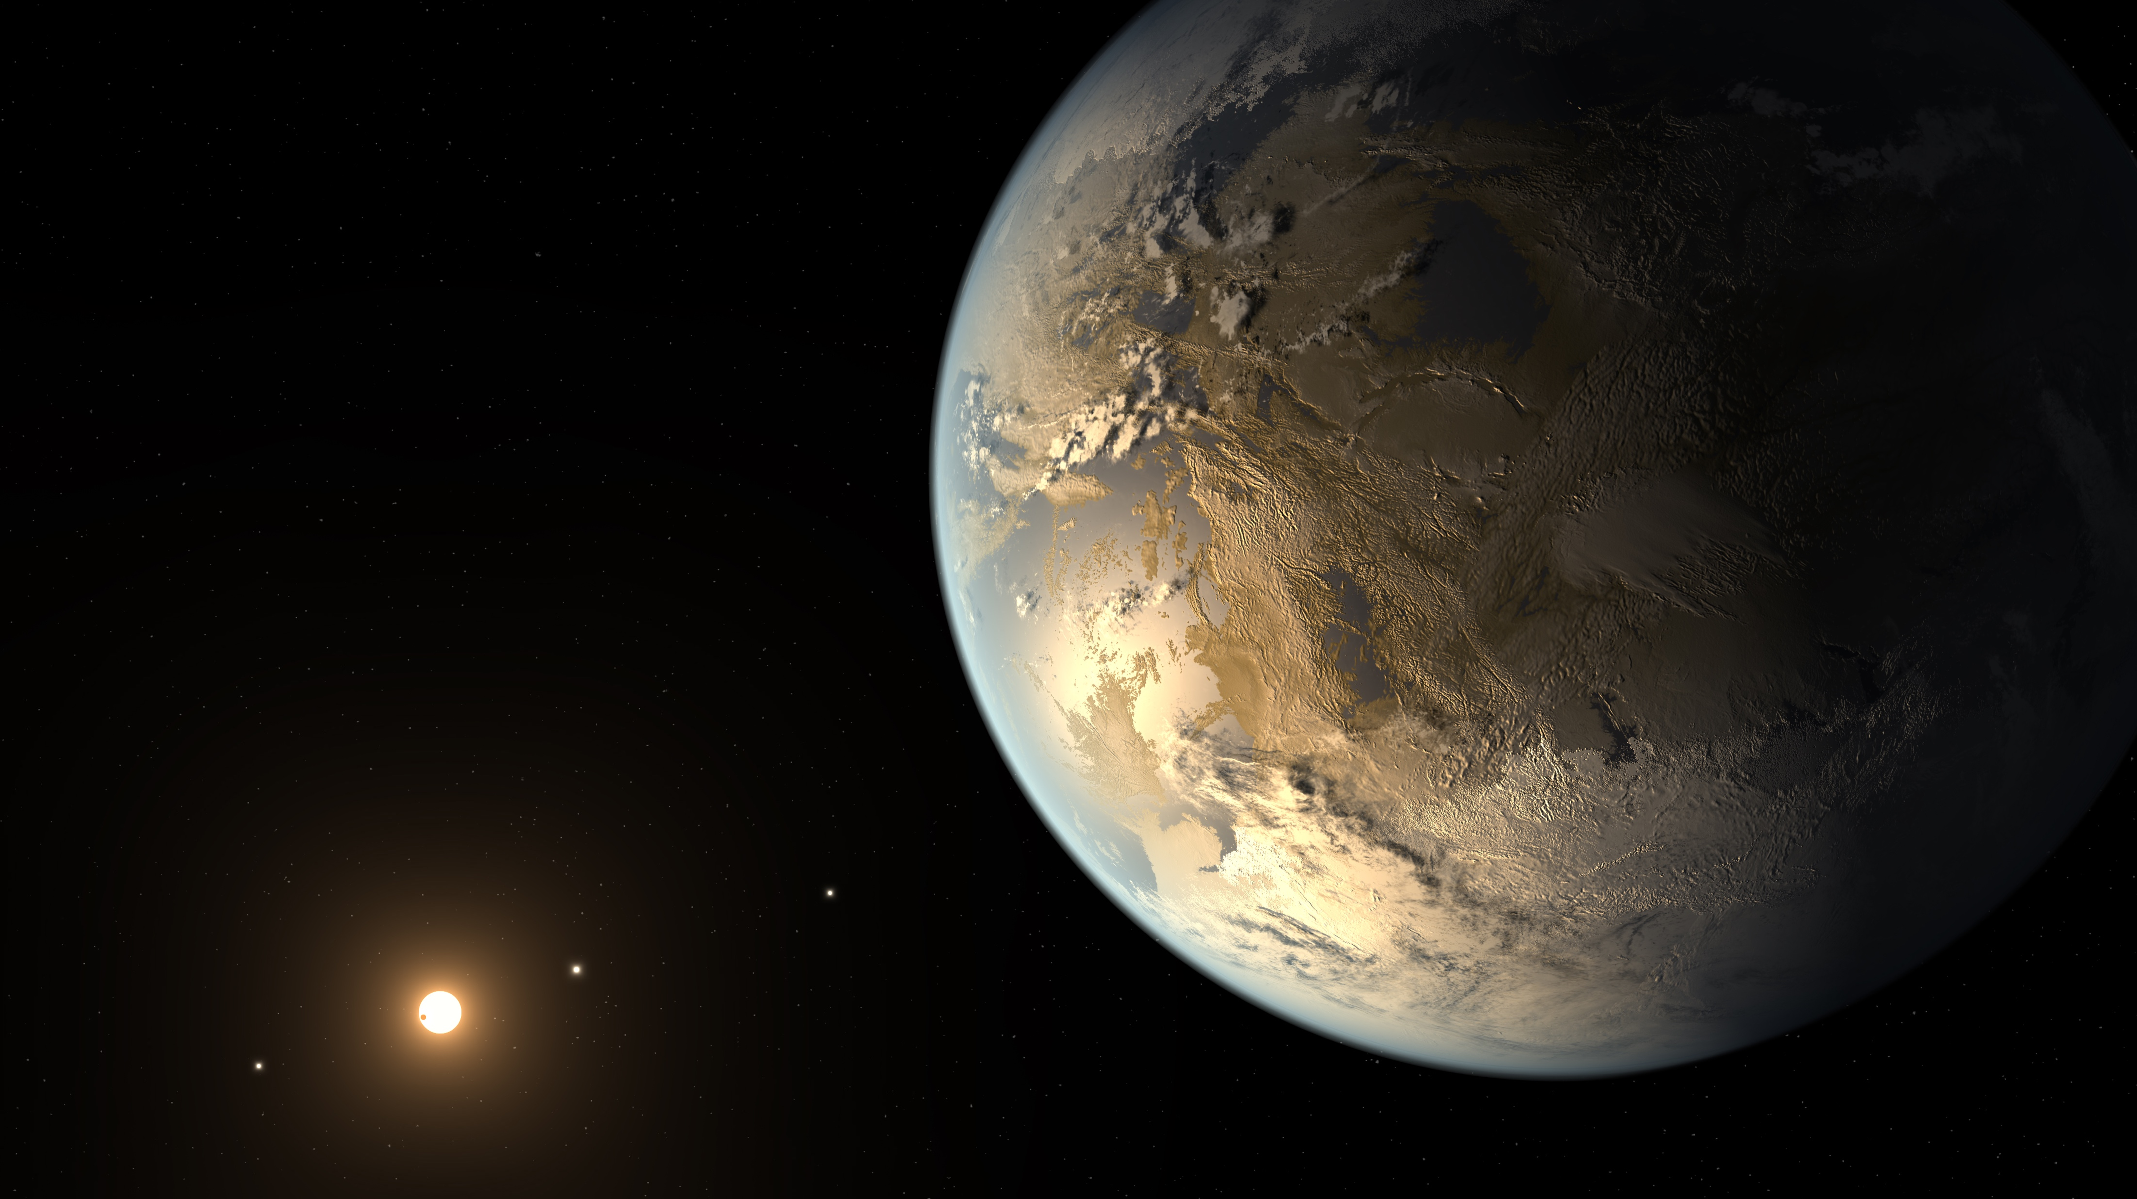
From Stars
To Galaxies
And Planets
Jennifer Johnson
Ohio State University

Slide 2
A big thank-you!
To all the previous speakers, for their excellent thought-provoking talks
and for setting up my talk so well
To the organizers, for this lively conference that did what it set out to do
and was aimed at me specifically

Slide 3
Stars, Planets, & Galaxies
Galaxies
Radial mixing
Solar neighborhood
Adding ages to metallicities
Refining ages for stars
[C/N] and extra-mixing
Stellar Isochrones
Asteroseismology
Planets
Stellar Multiplicity
The disappearance of close companions
Binarity & metallicity
Composition of Stars → Composition and Structure of Planets
C/O measurements in M dwarfs
Rocky Worlds and Birthstones
SDSS-V

Slide 4
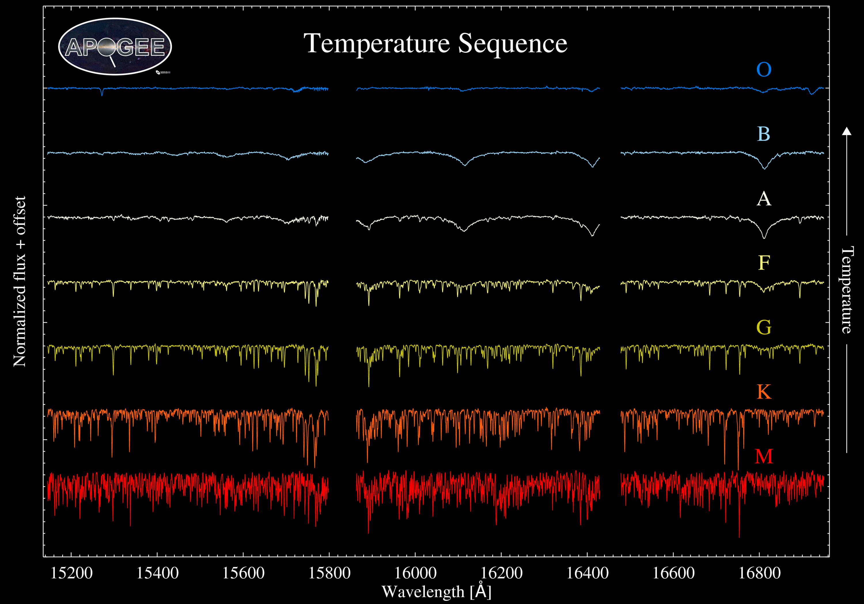
Majewski et al. 2017
Figure by Chojnowksi

Slide 5
APOKASC
Pinsonneault+ (2014)
Yvonne Elsworth
Saska Hekker
Aldo Serenelli

Slide 6
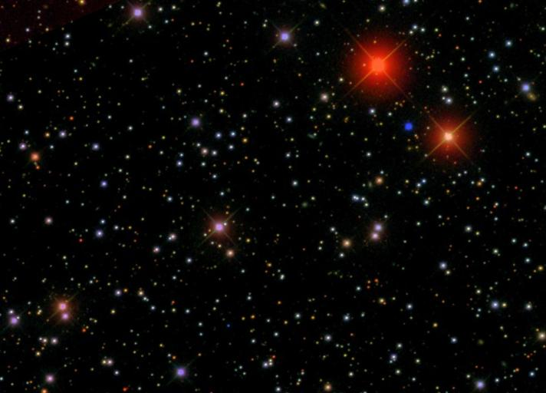
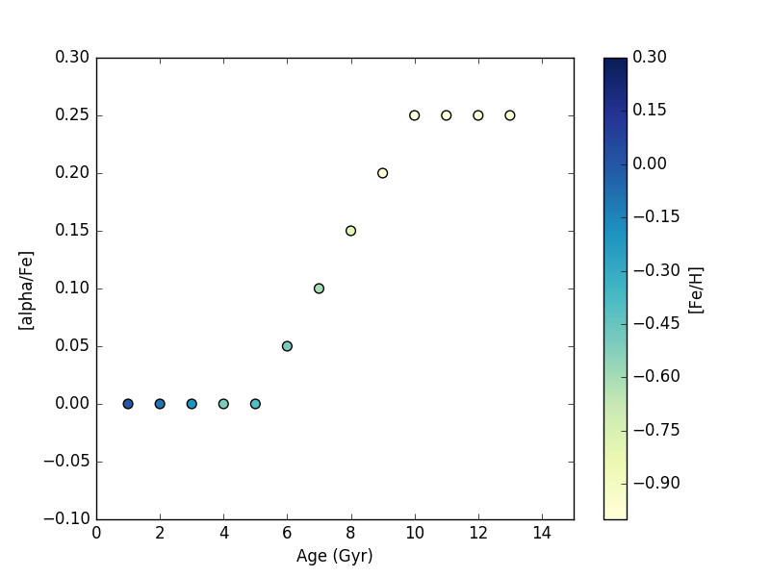
A Simple View of the Solar Neighborhood

Slide 7
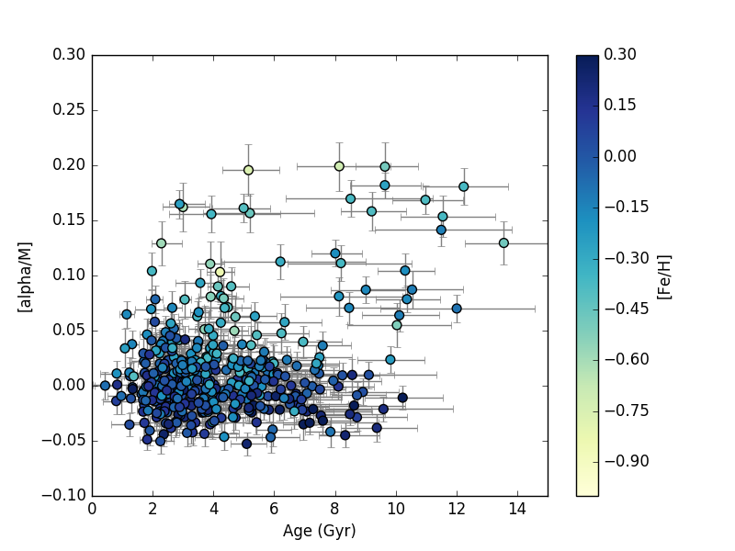
Age and Metallicity in the Solar Neighborhood – Need for Radial Mixing
APOKASC dwarf catalog – Serenelli et al, 2018

Slide 8
Wandering Stars
Favored idea to explain age-metallicity spread – radial mixing
Mechanism would need to operate on short timescales! Does it also explain the ages?
Hayden et al. 2014
Notes:
Theory can make stars move far from their birth radii! Note that these measurements are the stars of all ages at the present time. But can’t just move any old star, need a young one! An open question is where is the metal-rich gas that made these stars?

Slide 9
Mass-Metallicity Distribution for Secondary Red Clump
Stars in the secondary red clump have ages of ~1.5 +/- 0.5 Gyr
Not a complete MDF, but a clear spread in metallicty
Notes:
Exact age depends on metallicity
Can’t explain this by the slight mass-metallicity dependence, Z height or anything else we’ve tried

Slide 10
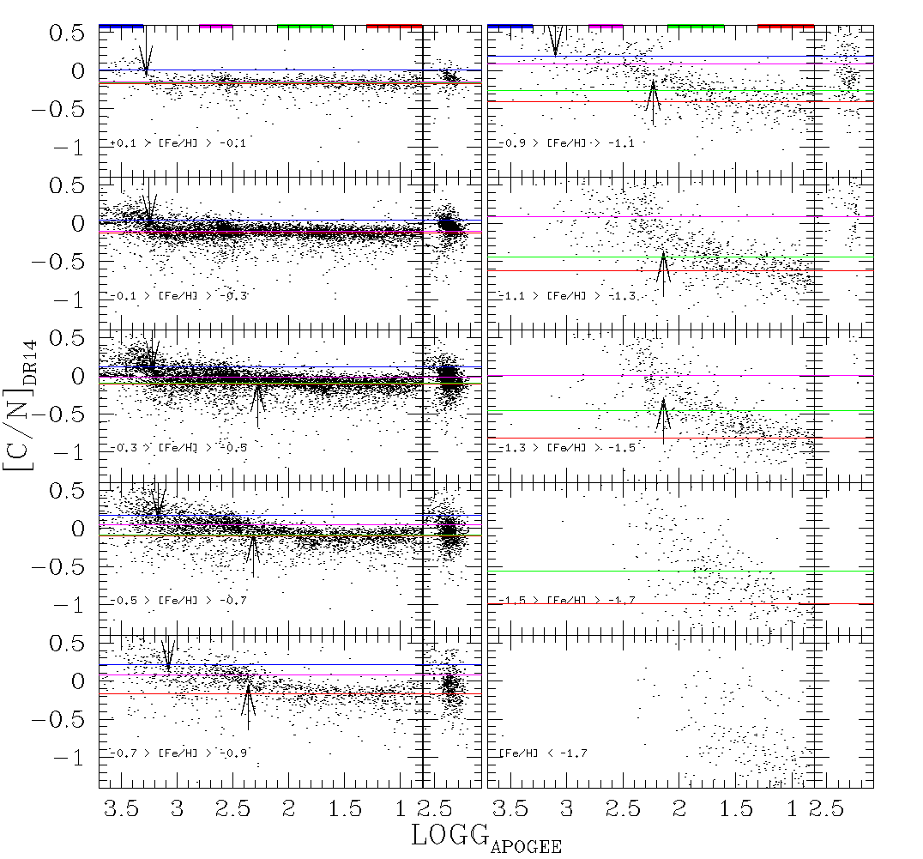
C/N and its discontents
Chemical evolution
Extra-mixing
Shetrone, Tayar, et al., in prep

Slide 11
Extra-mixing & Chemical Evolution
Shetrone, Tayar, et al., in prep

Slide 12
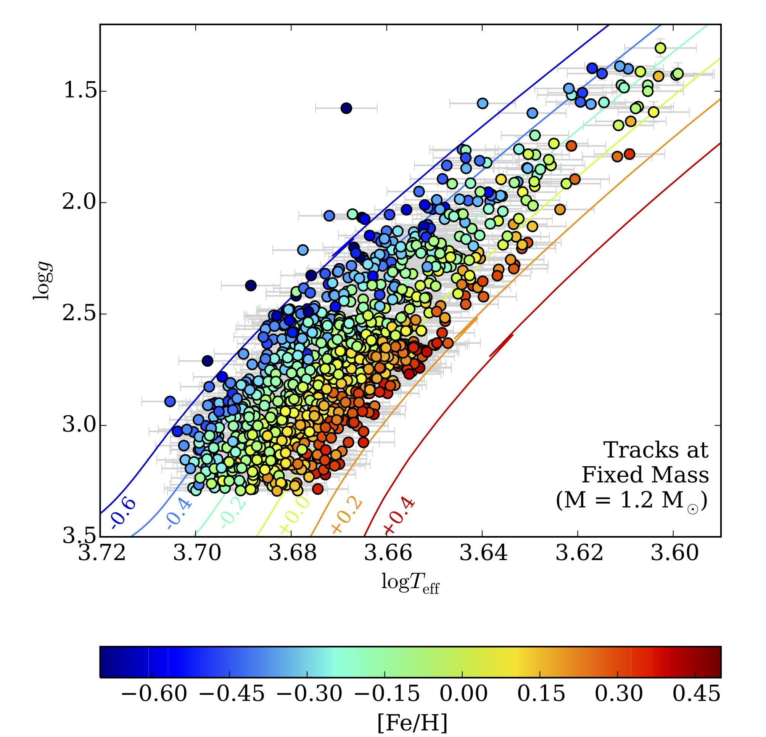
Red Giant Branch Models Currently Fail
Tayar et al. 2017

Slide 13
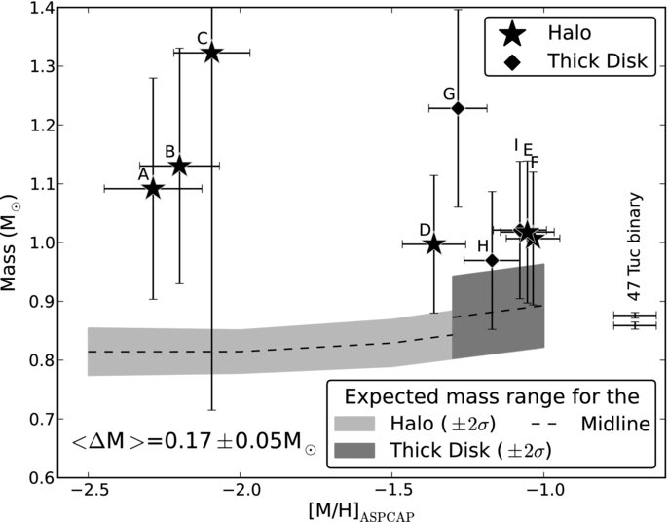
Towards Absolute Ages
Epstein et al. 2014

Slide 14
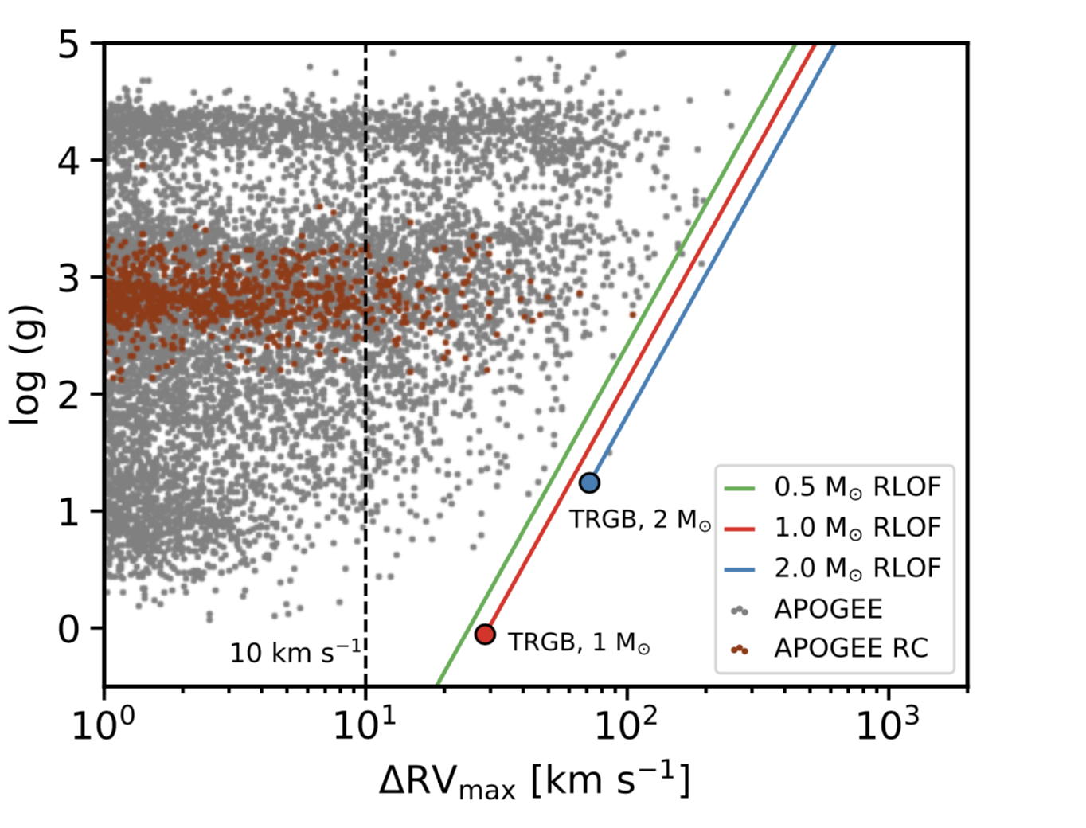
Where did the close companions go?
Badenes+ 2018

Slide 15
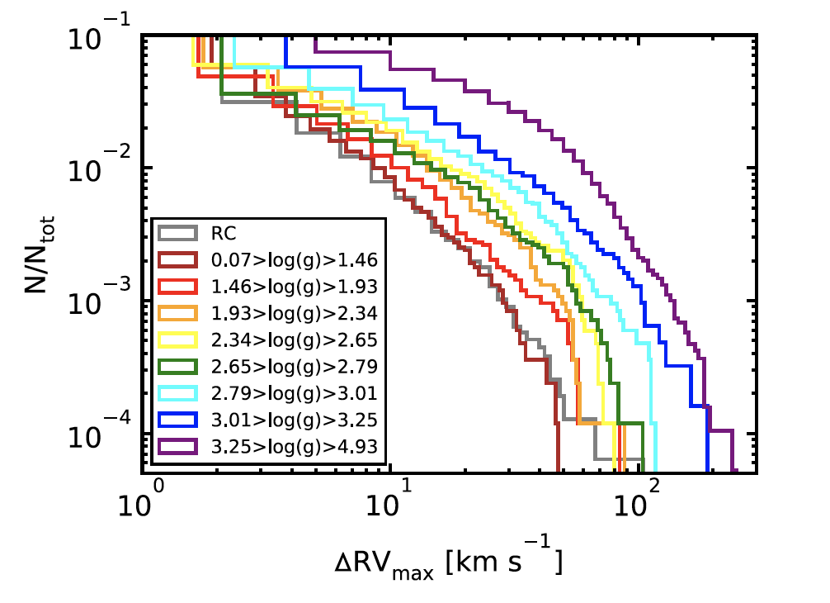
Swallowing companions
Badenes+ 2018

Slide 16
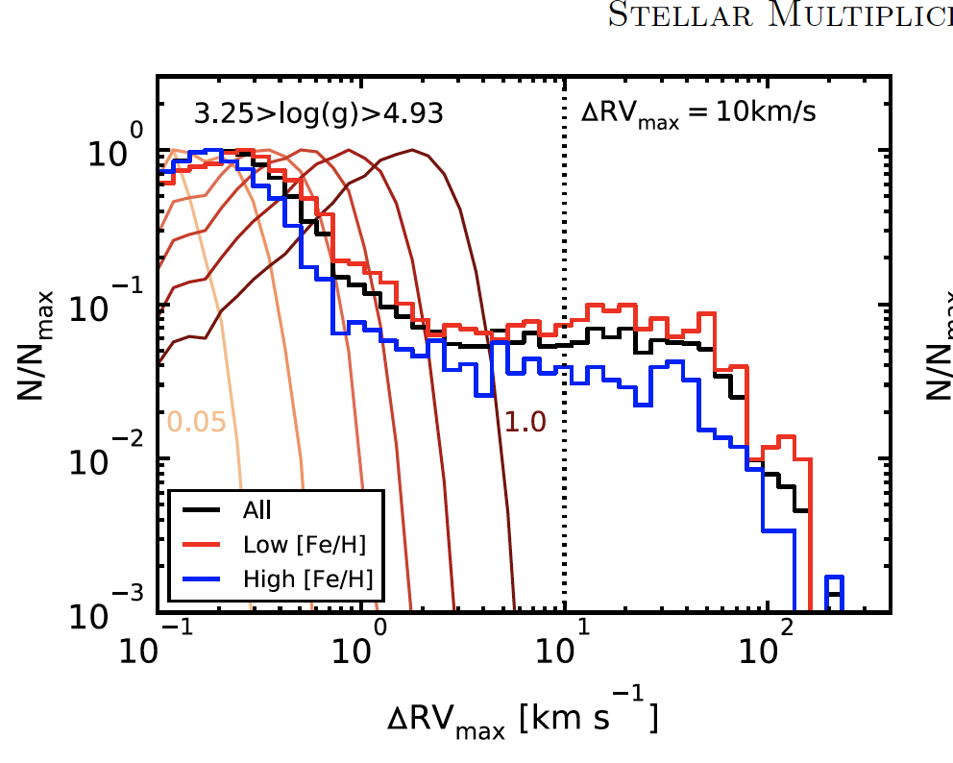
Metallicity and Binaries
Badenes+ 2018

Slide 17
What we can & cannot do for geophysics of exoplanets
We do not understand all of the geophysics of Earth, let alone the solar system
Plate tectonics as necessary for climate control is not at all certain
  We should have a retreat (or a Max-Planck department)
However, we can say (based on physics) whether a planet is more or less to convect, and this is interesting information
Testable: Effects on mass-radius relations
We can study stellar activity even if we don’t understand the Sun!

Slide 18
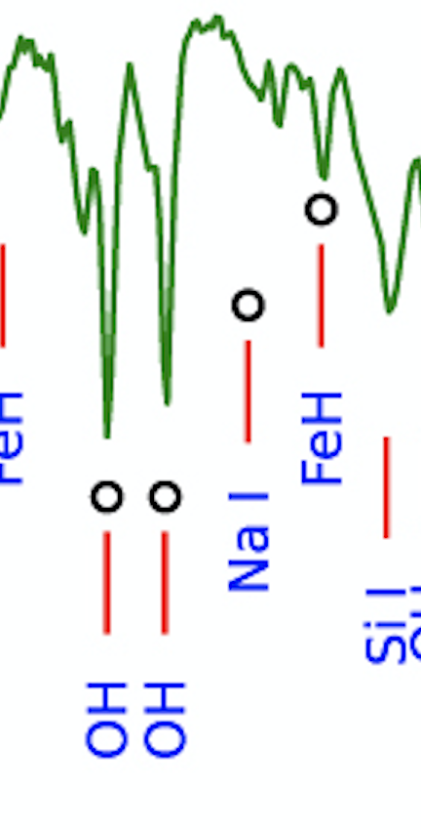
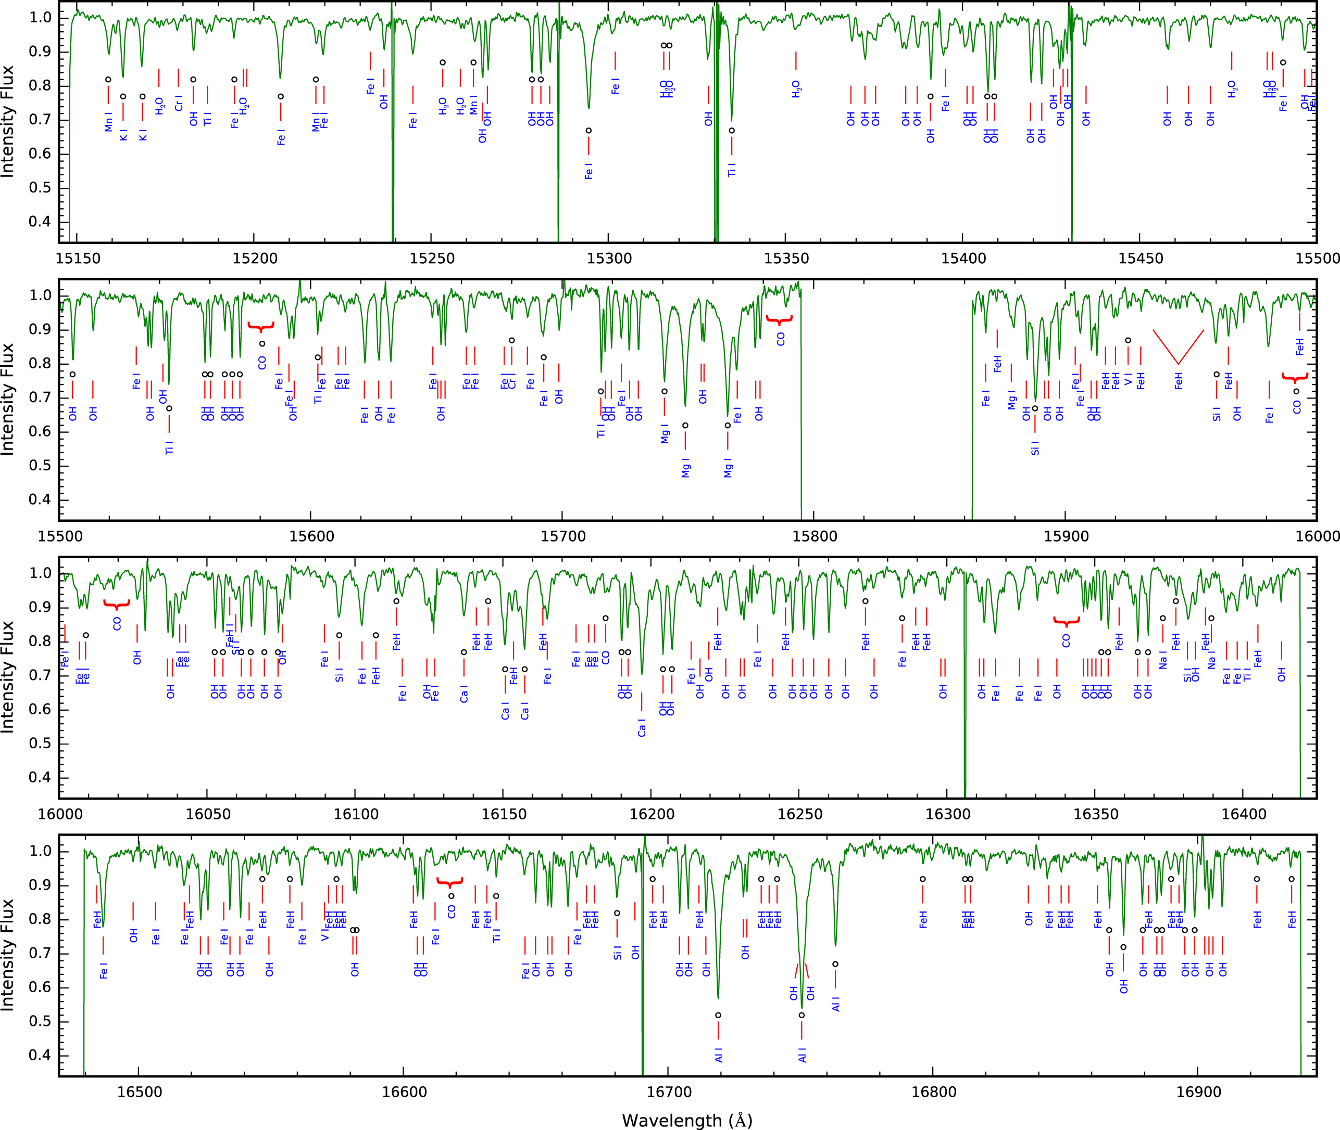
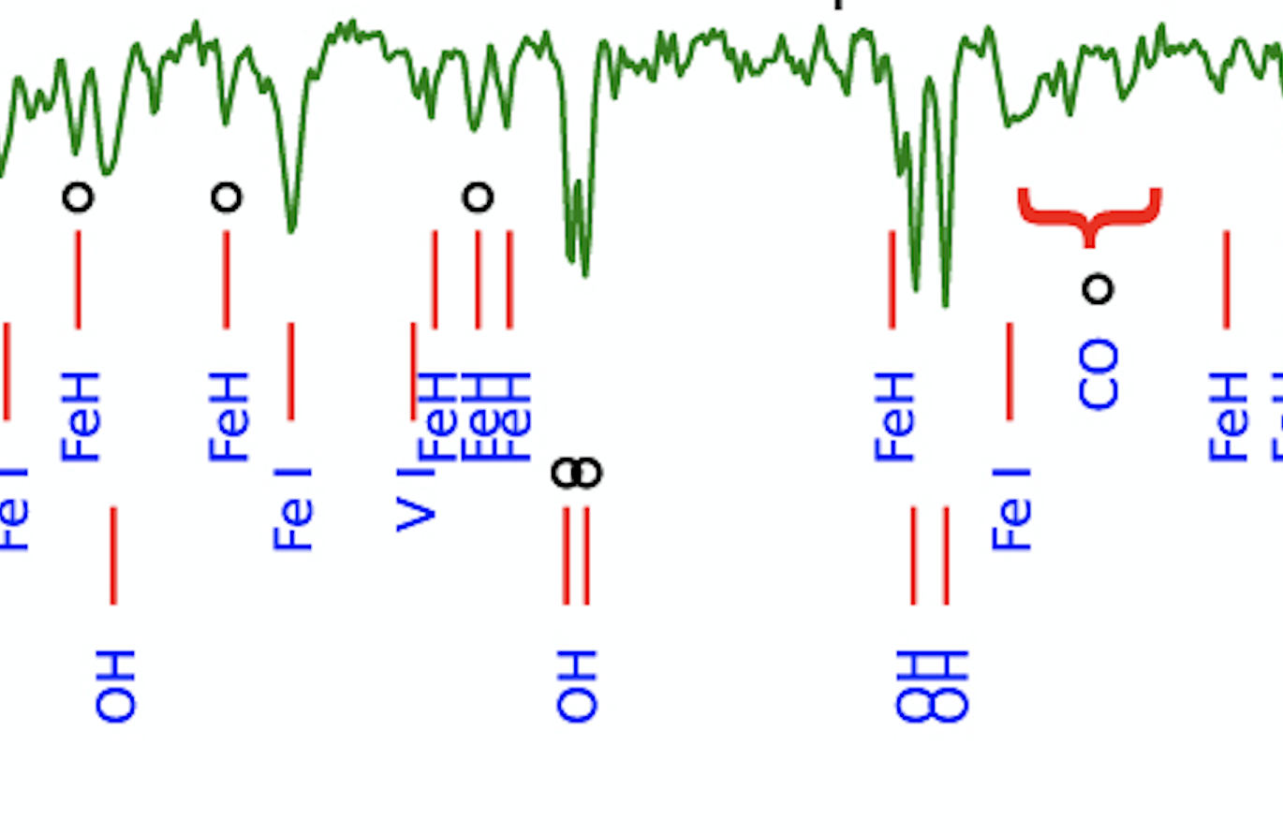
Measuring the composition of planet-hosting stars
Souto et al. 2017
Kepler-138 and -186
also Ross 128 coming soon!

Slide 19
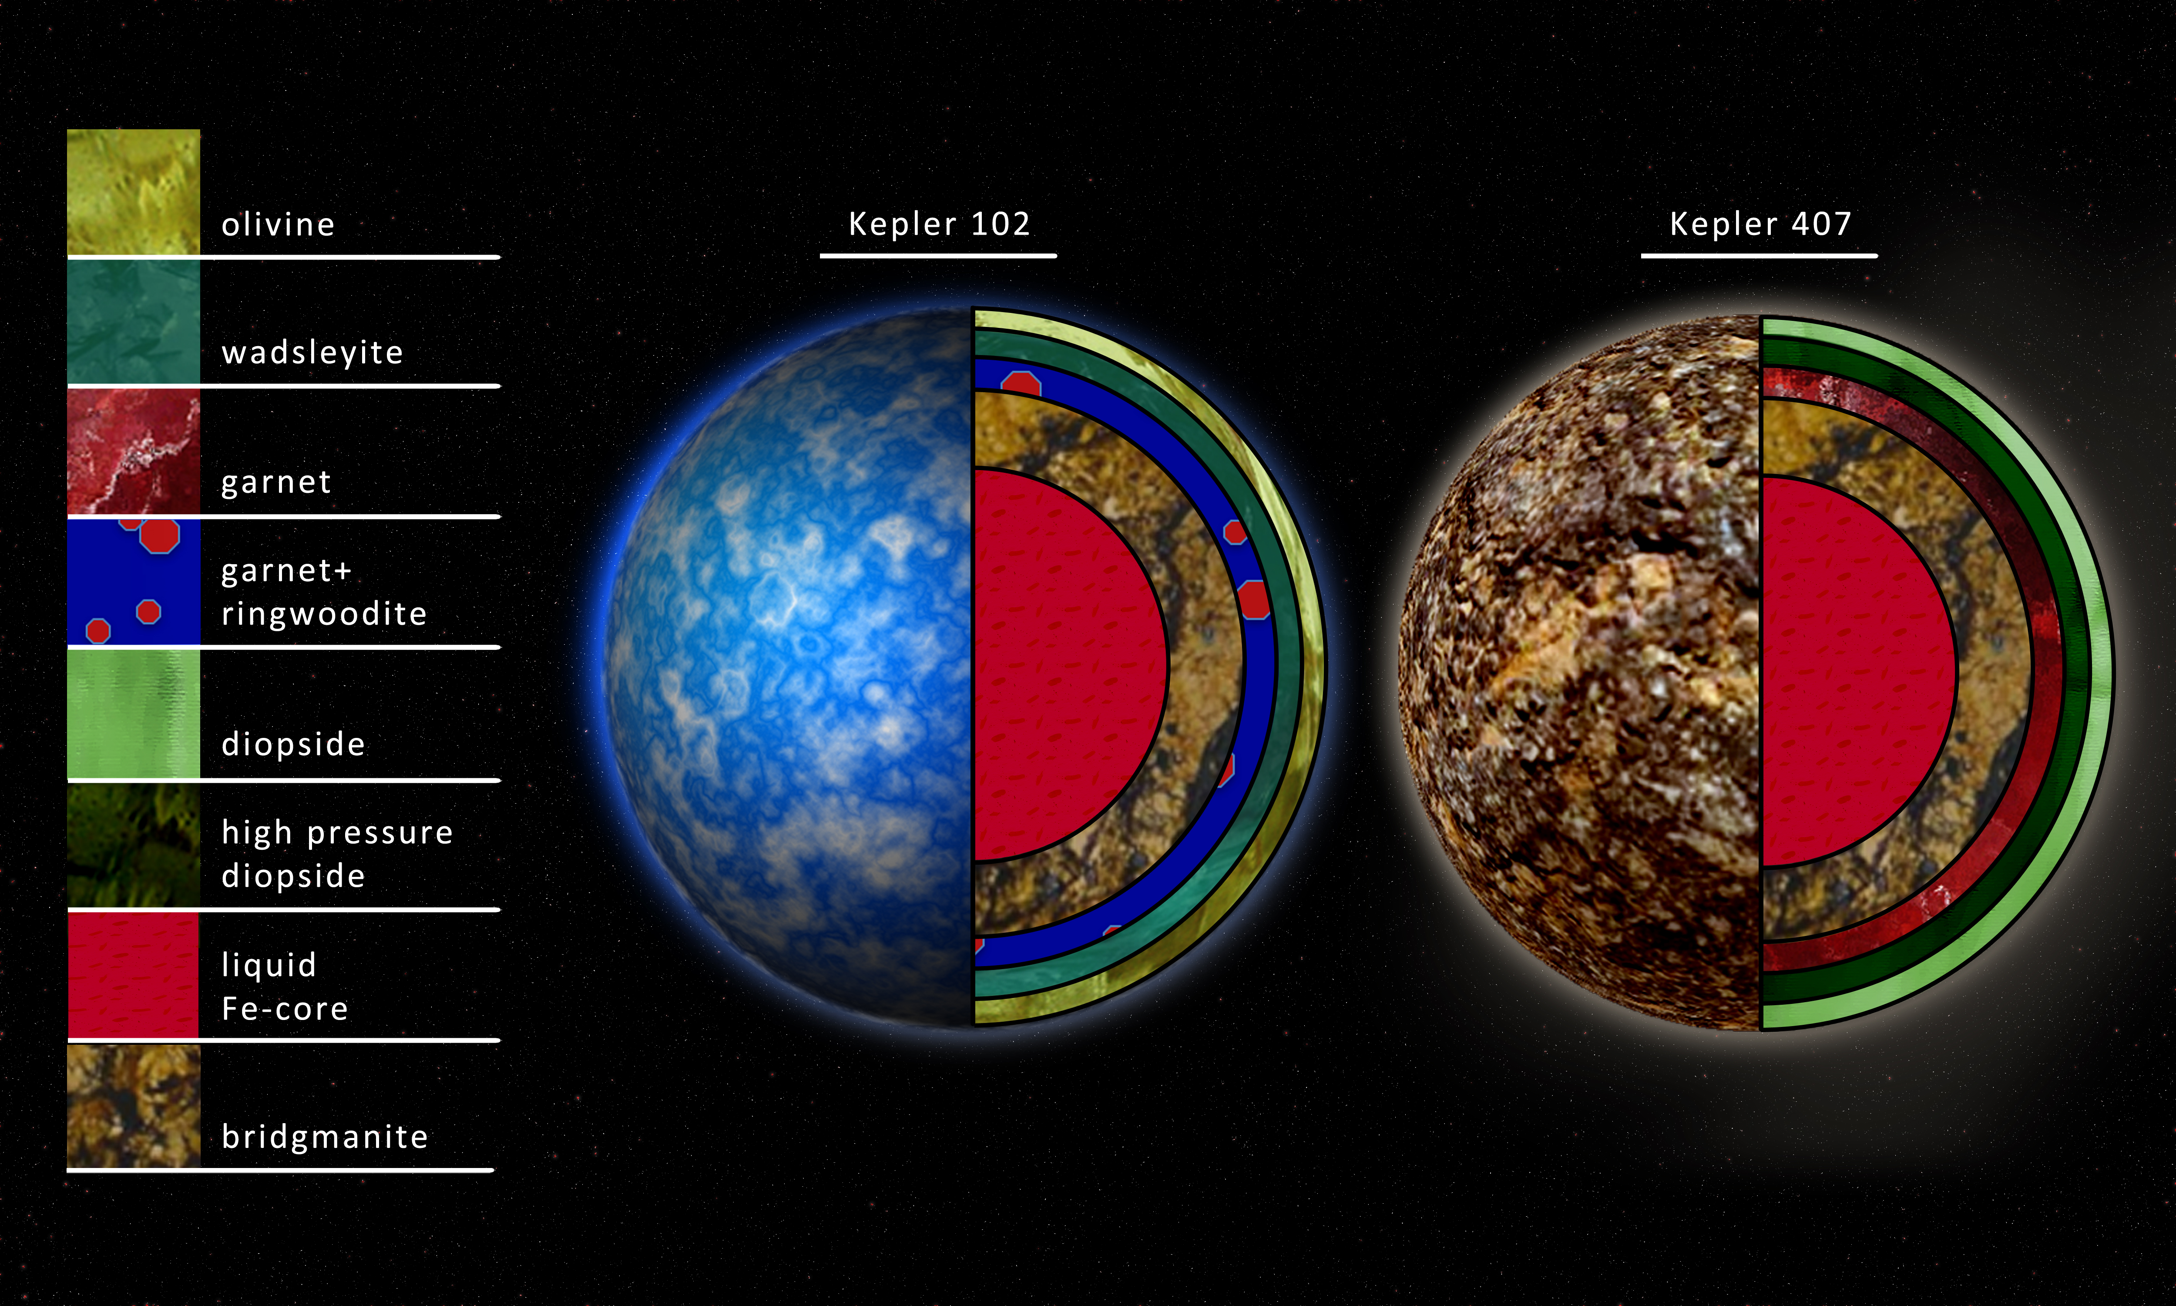




We can test whether this is correct by its effect on the mass-radius relation for the best measured TESS rocky worlds (closer is better – don’t need to be habitable)
C. Unterborn J. Teske W. Panero S. Hull

Slide 20

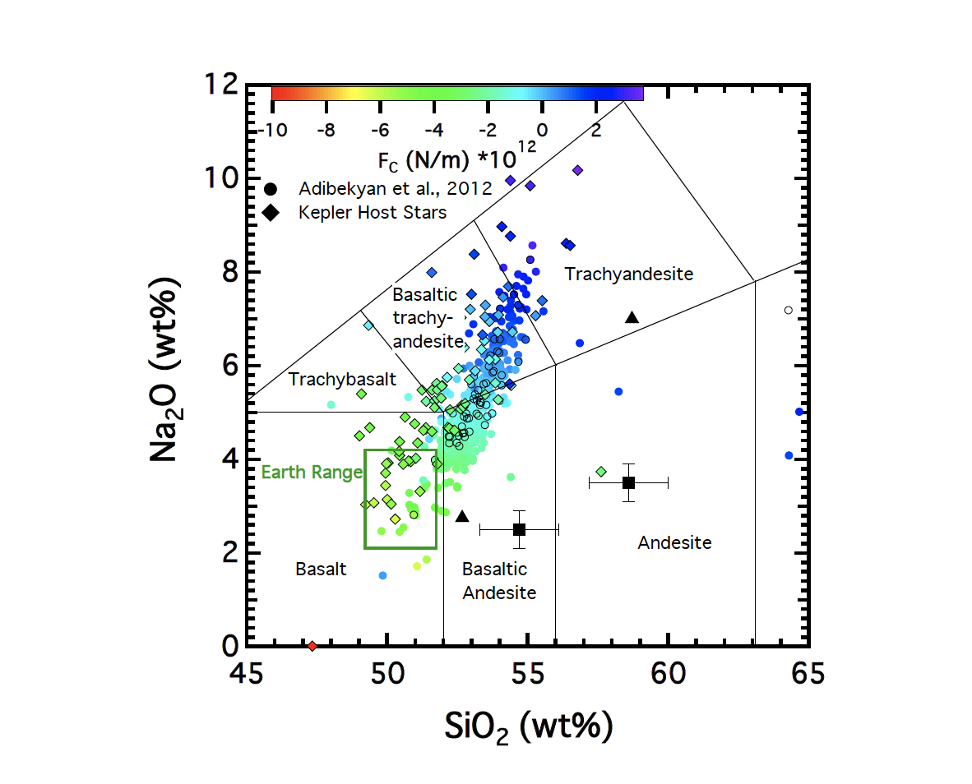
Sink or Swim?
Unterborn+ 2018

Slide 21
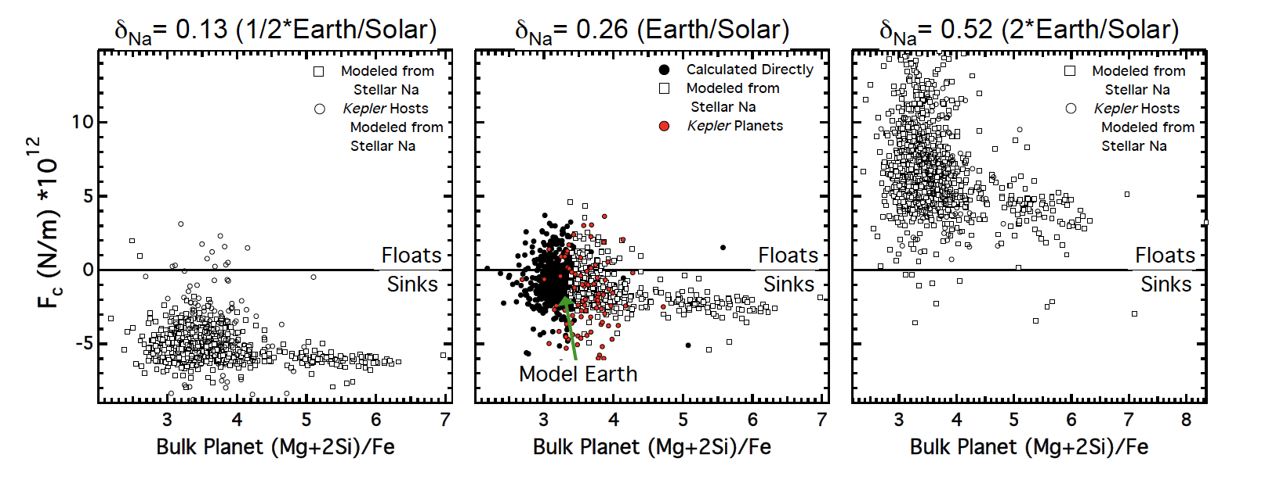
Sink or Swim?
Unterborn+ 2018

Slide 22
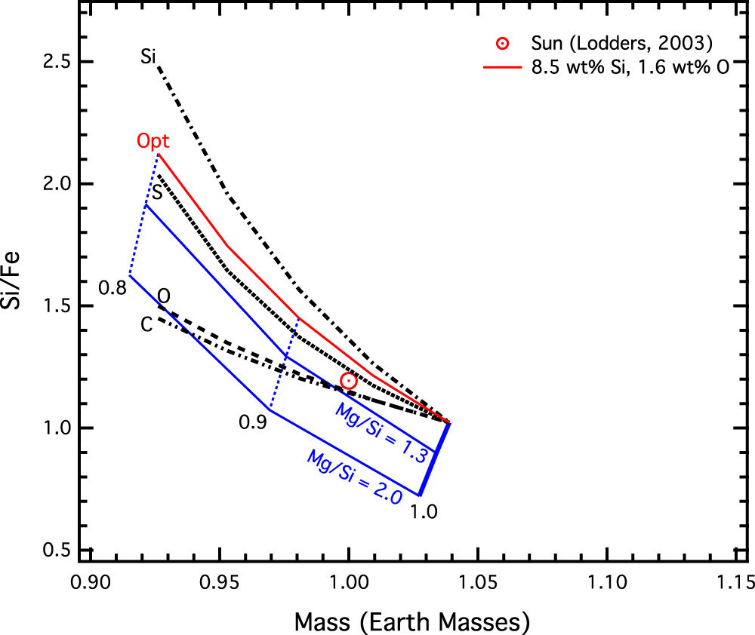
The Earth as an Exoplanet
Unterborn+ 2016

Slide 23

The Future & SDSS-V

Slide 24
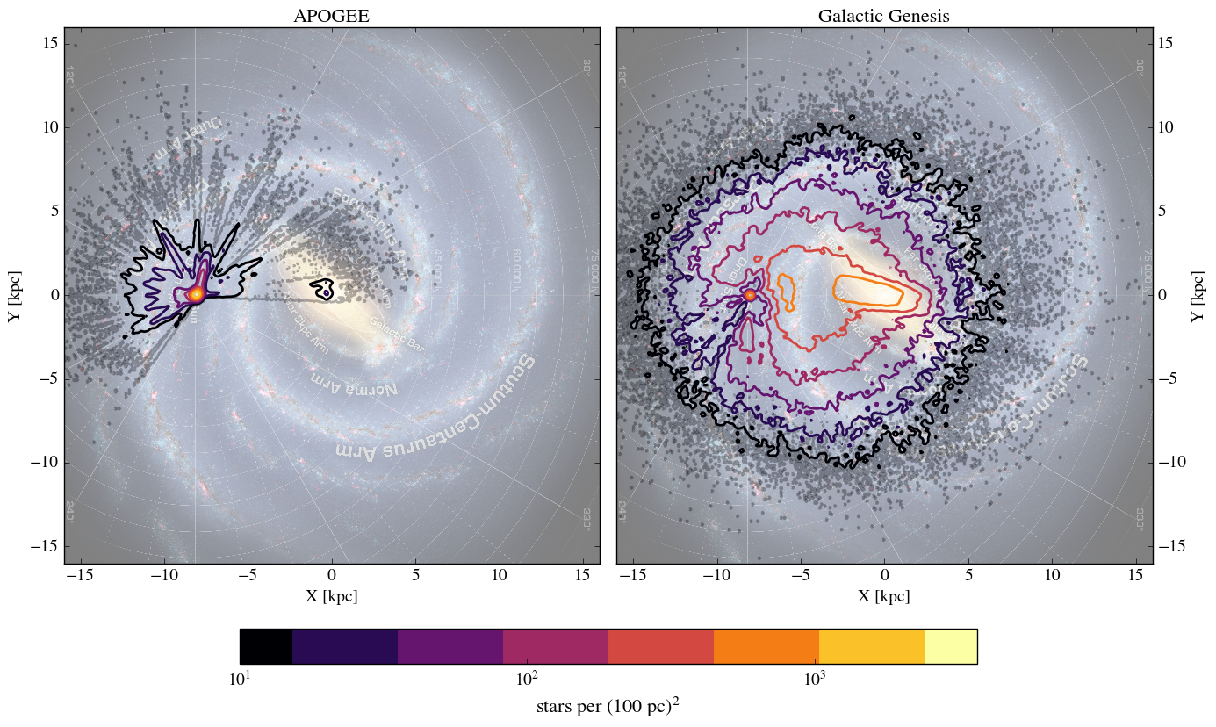
Milky Way Mapper – Galactic Genesis
~5 million stars with H < 11 mag, G-H > 3.5 mag, S/N > 40
Figure by J. Bird
Notes:
G-H limit is to get the reddened stars that the Gaia RVS will not get good stellar parameters/abundances for, but will have proper motions (and in some cases distances). As the figure on the right shows, we will go deep into the dust-obscured disk.

Slide 25
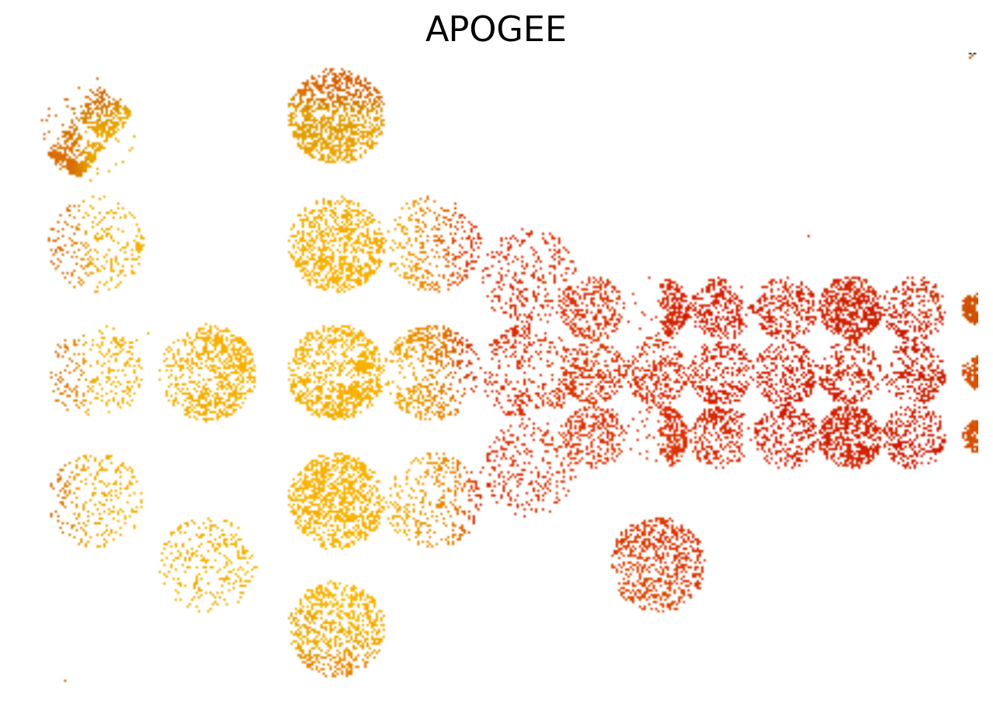
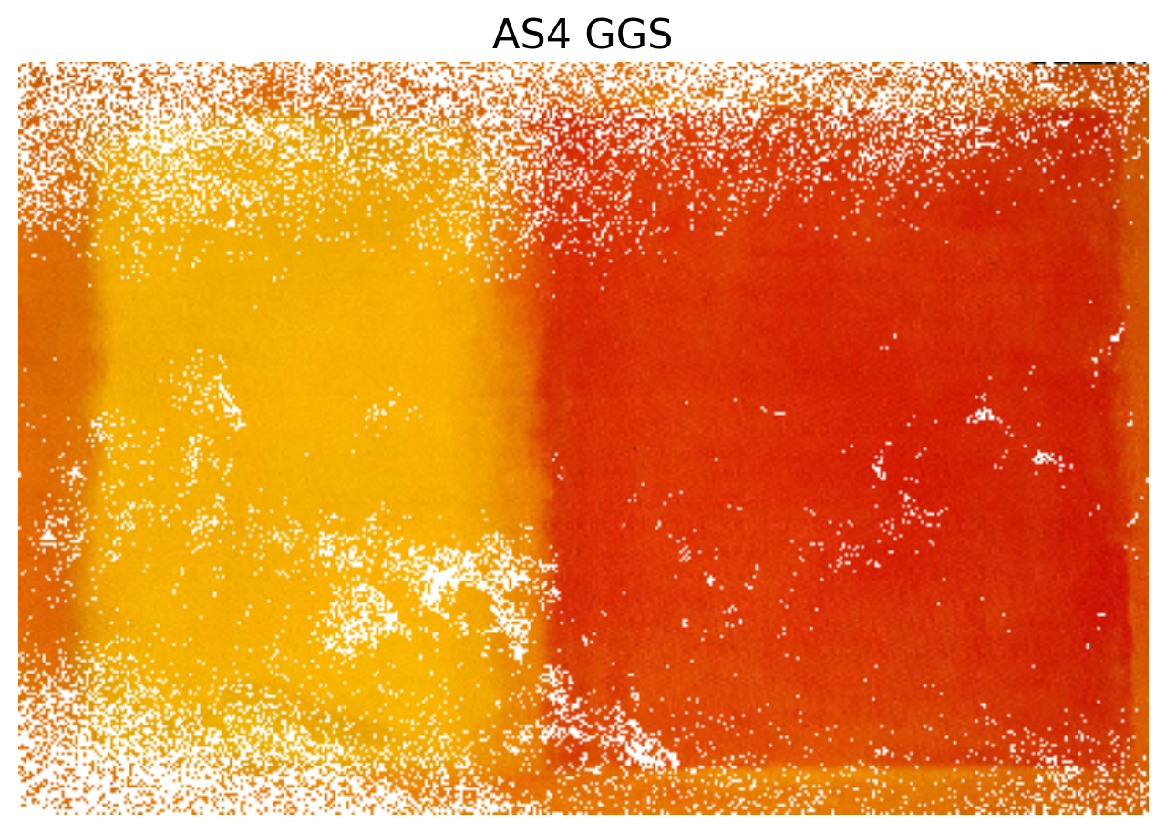
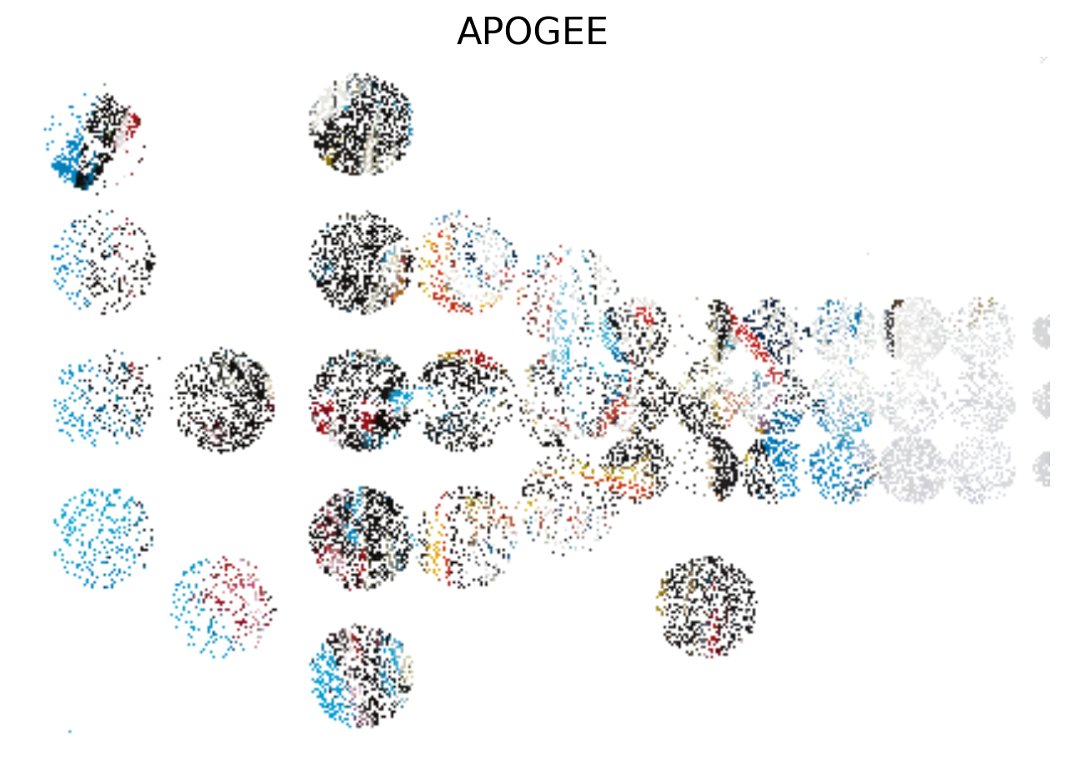
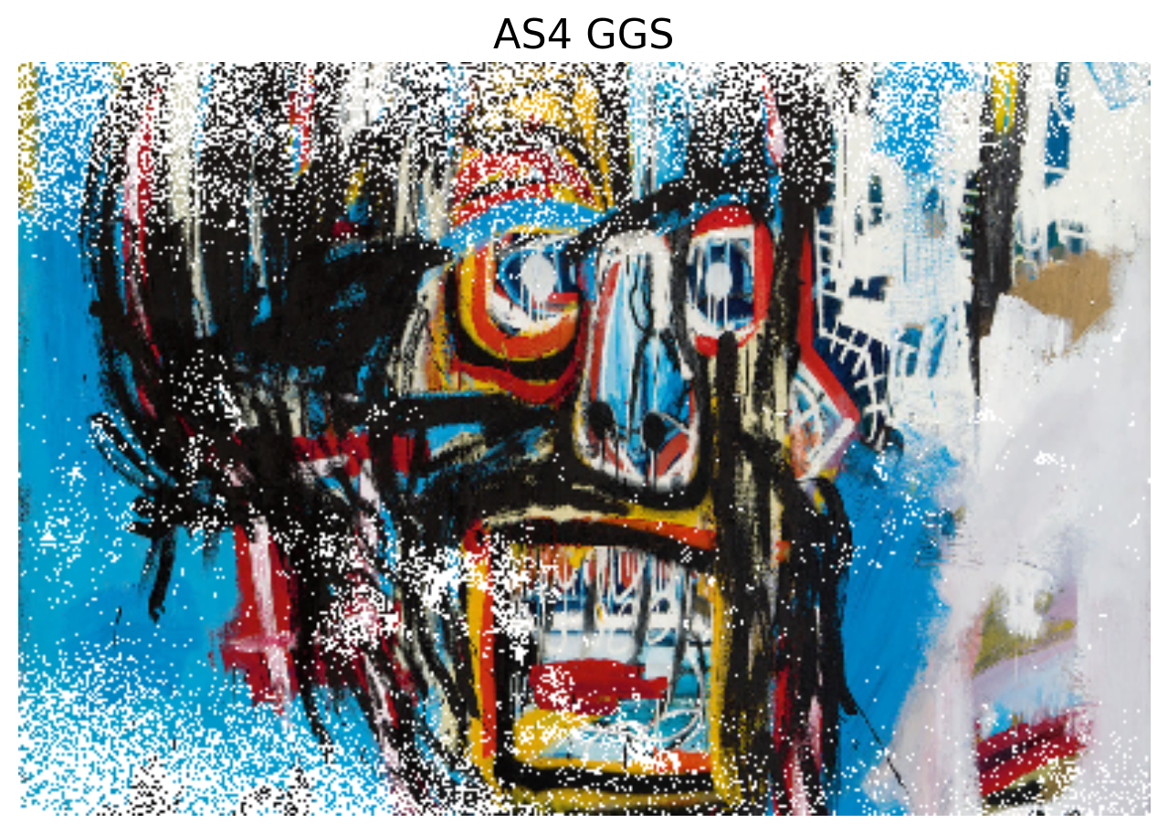
Densely sampling galactic stars matters
courtesy: Jon Bird
Notes:
If the Milky Way were as simple as a Rothko painting, we might not need dense sampling.
But, it may be more like a Basquiat painting

Slide 26
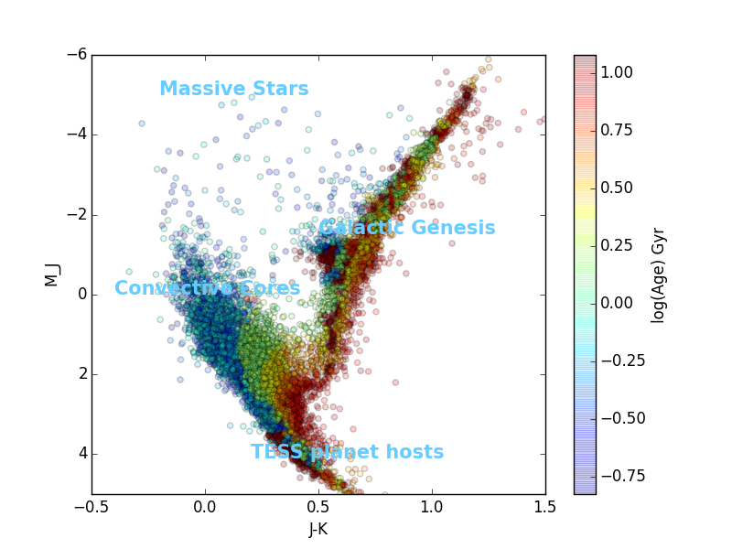
Milky Way Mapper – Stellar Astrophysics
AS4’s all-sky multi-epoch spectroscopy is an awesome machine for stellar science. Hundreds of thousands of stars in each category:
Synergy with asteroseismology & transit studies with TESS & PLATO
RVs across the HR diagram for binary studies at all masses
IR spectra for census in SF regions & tie to ISM
Age info for evolved stars in binaries/white dwarfs/& red giants (core of GG proposal)
Figure by L. MacArthur/D. Hogg/J. Johnson
Notes:
A small fraction of the HR diagram from Gaia DR1 (there were 1 million, I’ve plotted around 10,000) If you need numbers for these, Table J,1 in the Sloan proposal has them.

Slide 27
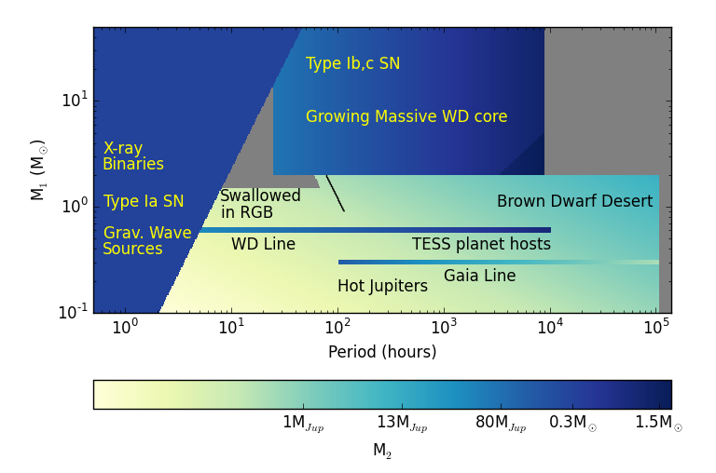
Milky Way Mapper – Binary Studies
Figure by J. Johnson
Notes:
Extra Figure: See caption in SDSS

Slide 28
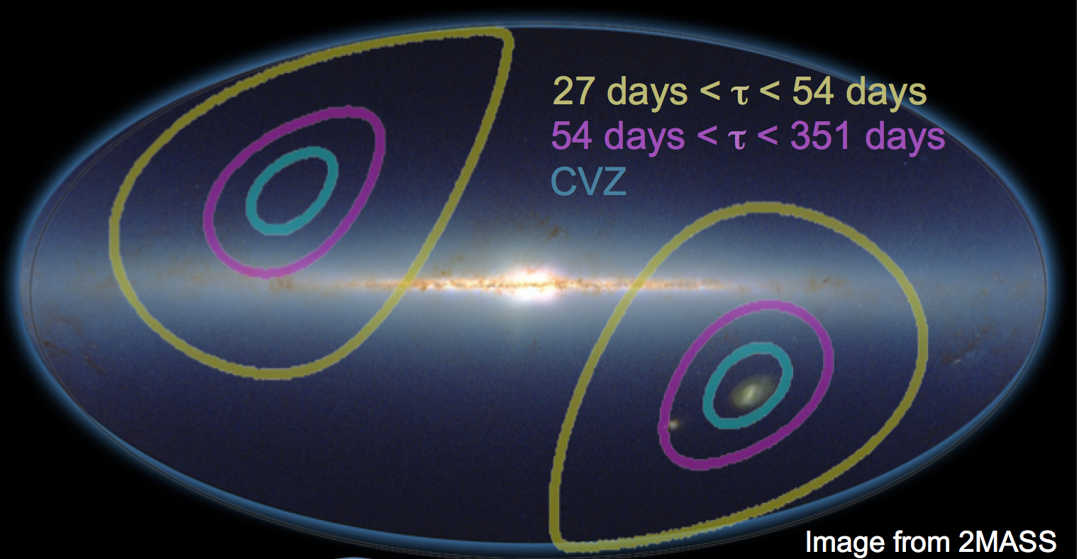
TESS & Galactic Archaeology
Luminosities from Gaia will be a vital part of understanding these data.

Slide 29
Resolving these scales offers a qualitatively different view of the ISM and requires targeting very nearby galaxies.
MANGA

Slide 30

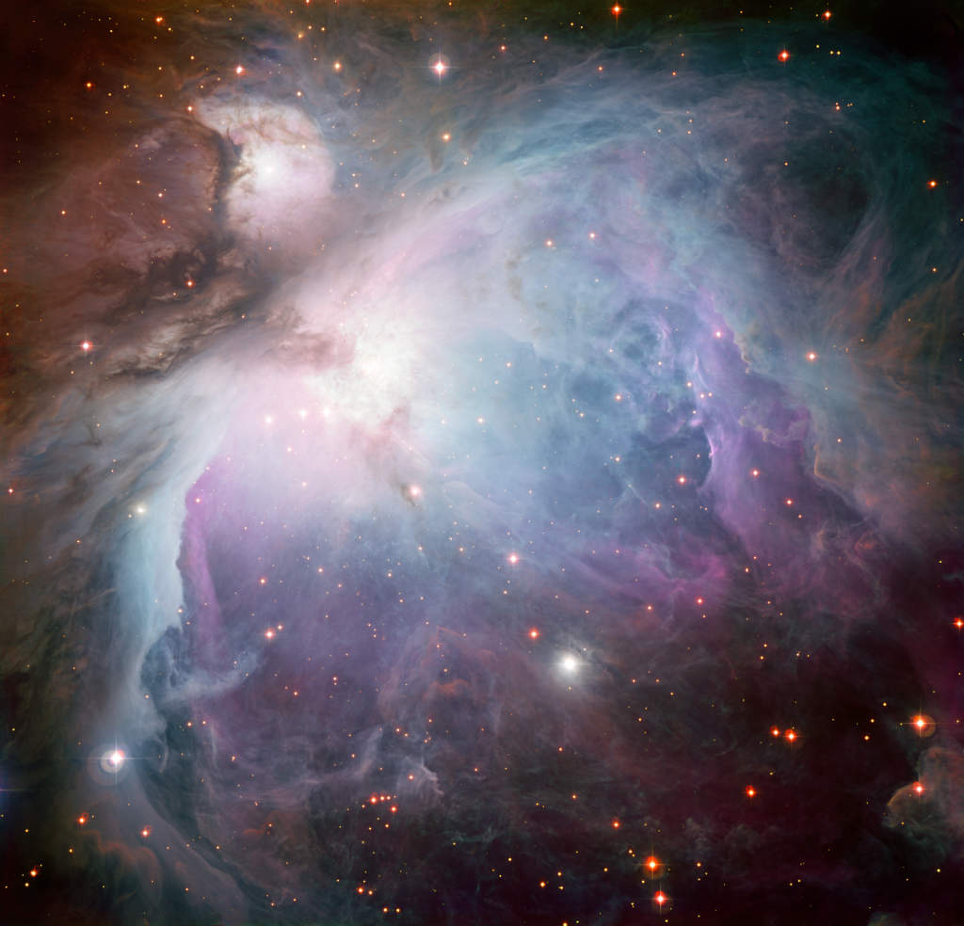
Orion
M42 0.07 pc / spaxel
APOGEE stars (yellow)
Combine information from gas and stars to map the interaction between stars and ISM
Have Teff, L, Z, [X/H], fuv, (age) for each star
Gas: temperature, density, kinematics, abundances
Images: ESO 2.2m

Slide 31
Golden Age of Stellar & MW Studies
Astatine
Iridium!
THANK YOU!

Slide 32
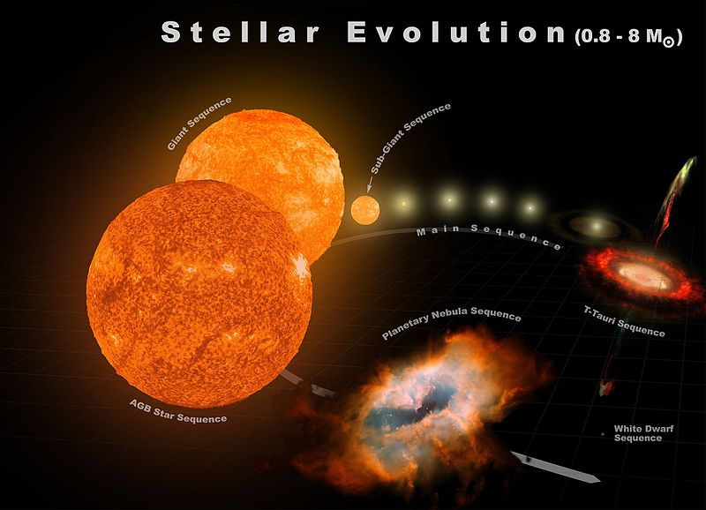
The End
For now!

