Slide 1
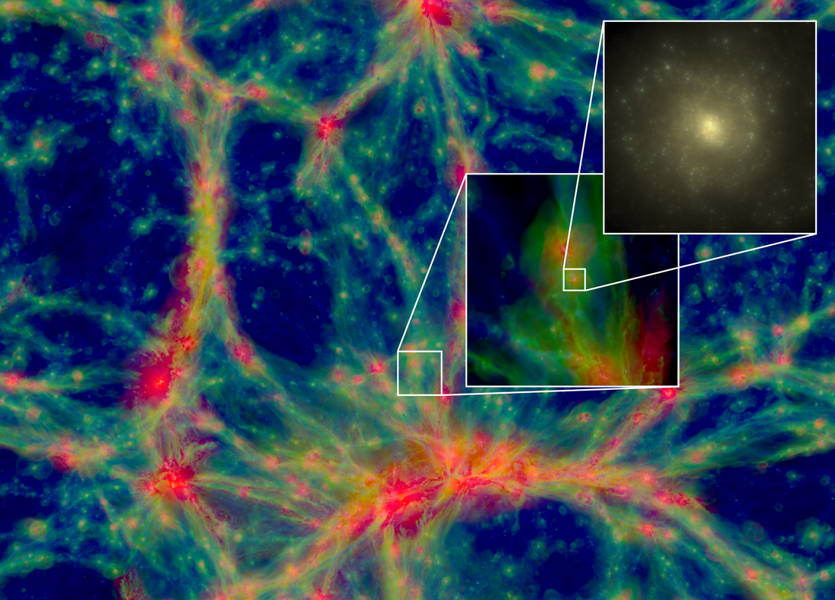


Using stars to probe galaxy formation
and evolution
STARS, PLANETS AND GALAXIES 2018
Maurizio Salaris

Slide 2
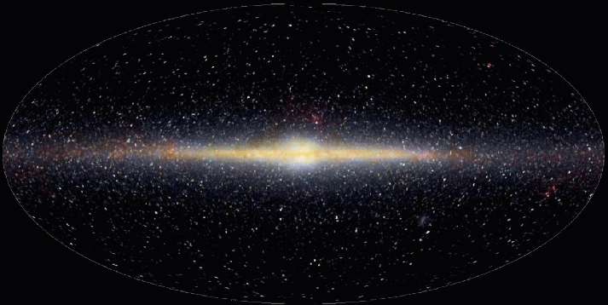
We can trace the Milky Way history using the measured motions and chemical composition of its constituent stars, complemented by estimates of their ages
For external, resolved and unresolved galaxies, we can in principle determine total stellar masses and ages (or Star Formation Histories)

Slide 3
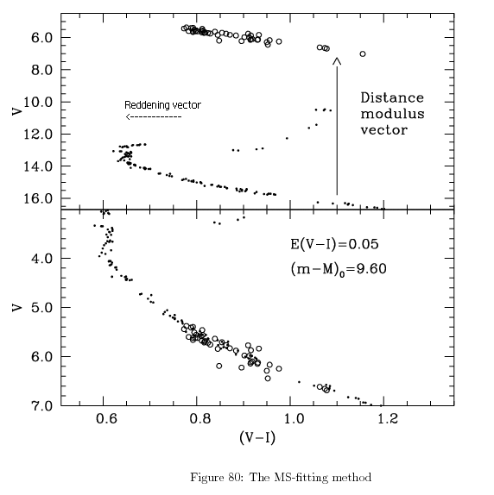
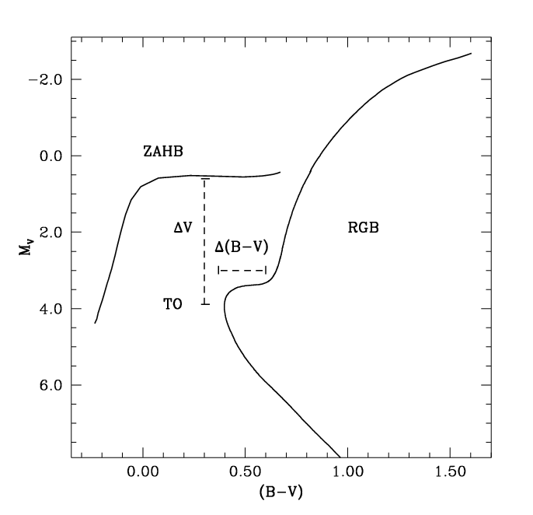
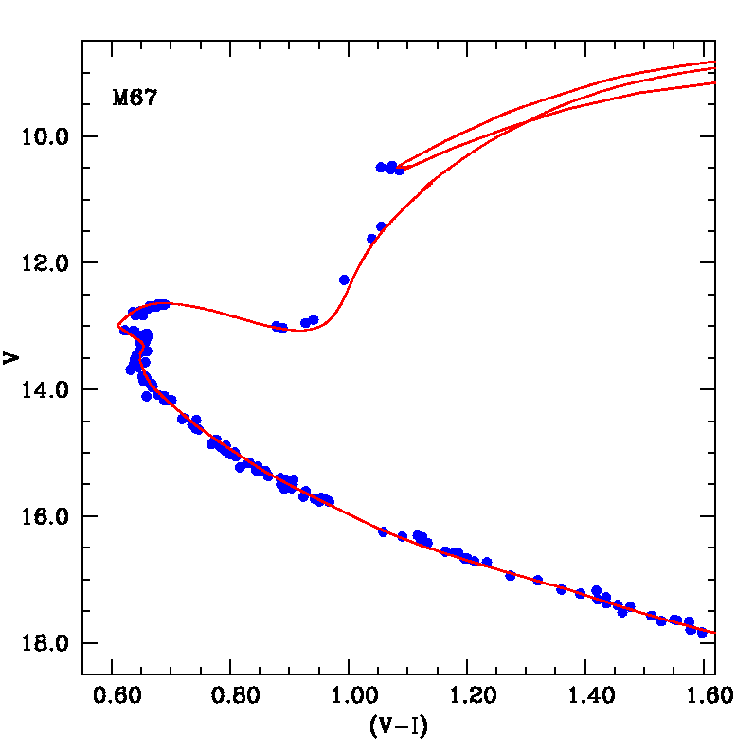
The bare minimum
Star clusters
Star clusters
Use only morphological information
Just TO brightness
TO brightness/colour relative to an age-independent phase
Full isochrone brightness and colour
ranges

Slide 4
Morphology and surface abundance predictions
Field star ages
Lin et al. (2018)

Slide 5
Lin et al. (2018)

Slide 6
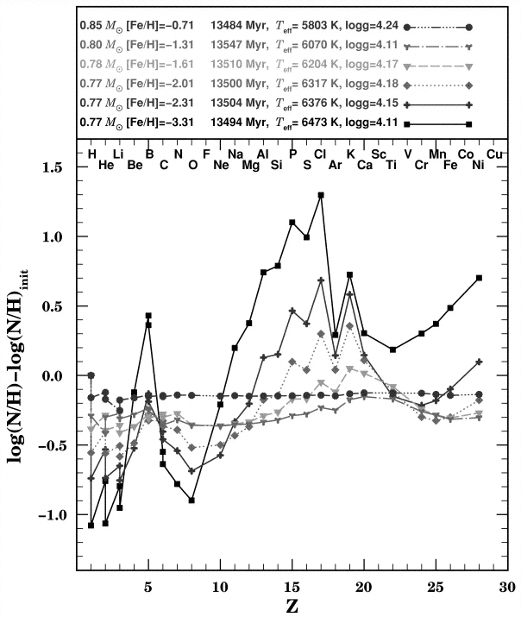
Matching
models to observed [Fe/H]
Effect of ‘diffusion’
but we don’t see this in Galactic GCs
(plus the existence of the Li Spite plateau )
Richard et al. (2002)

Slide 7
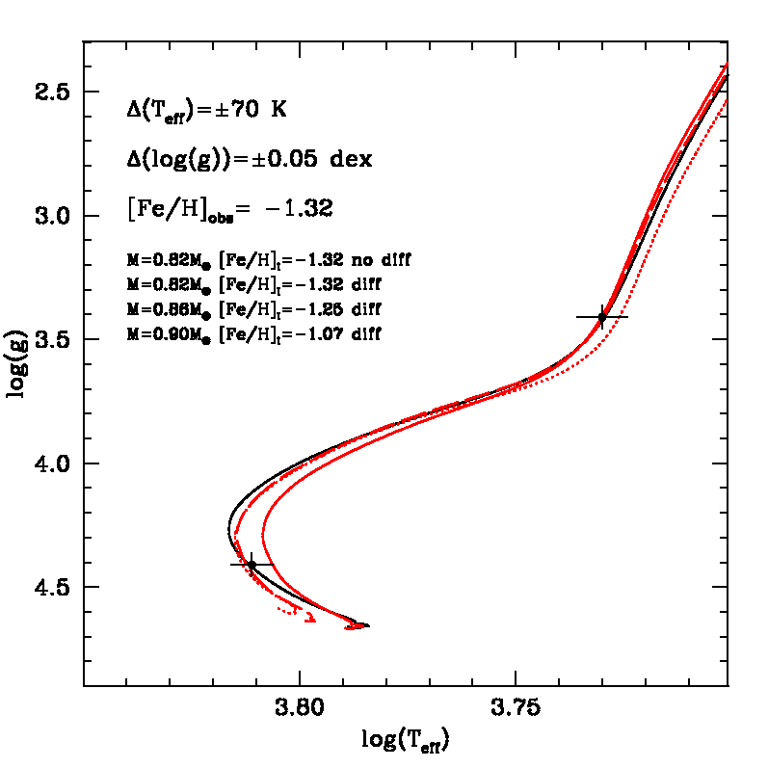
EFFICIENCY OF ATOMIC DIFFUSION AND AGE OF FIELD STARS
Salaris et al. (2000)
Salaris (2016)
Dotter et al. (2017)
MS
Δ[Fe/H]=±0.10
≅8.5 Gyr
≅6 Gyr
≅5 Gyr
Black solid
Red solid
Red dashed
Red dotted
We need 2% accuracy on
mass to reduce systematics due to diffusion efficiency to ~10%
Large age uncertainty if we do not know the stellar mass

Slide 8
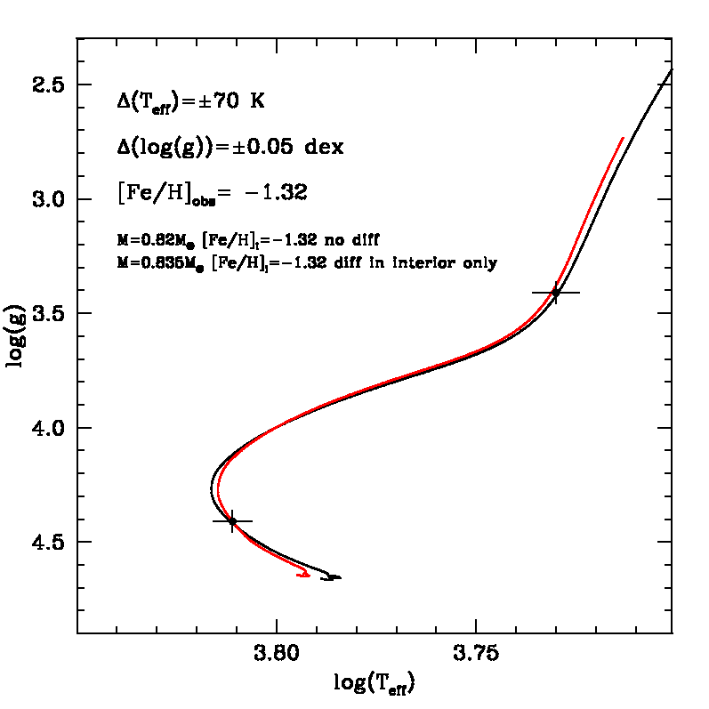
Zero-order test with atomic diffusion completely inhibited from envelopes
Only below conv env.
1.3 Gyr age difference difference
~1.3 yr age difference

Slide 9
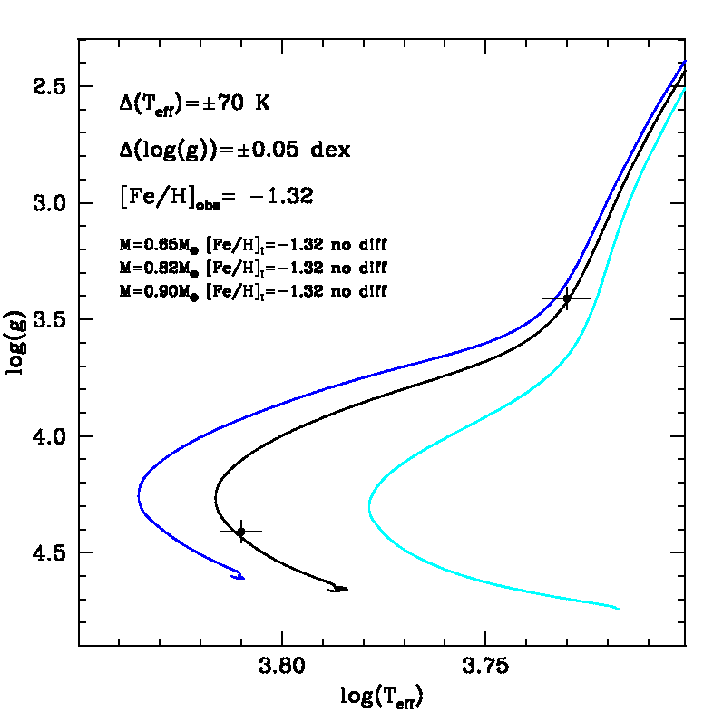
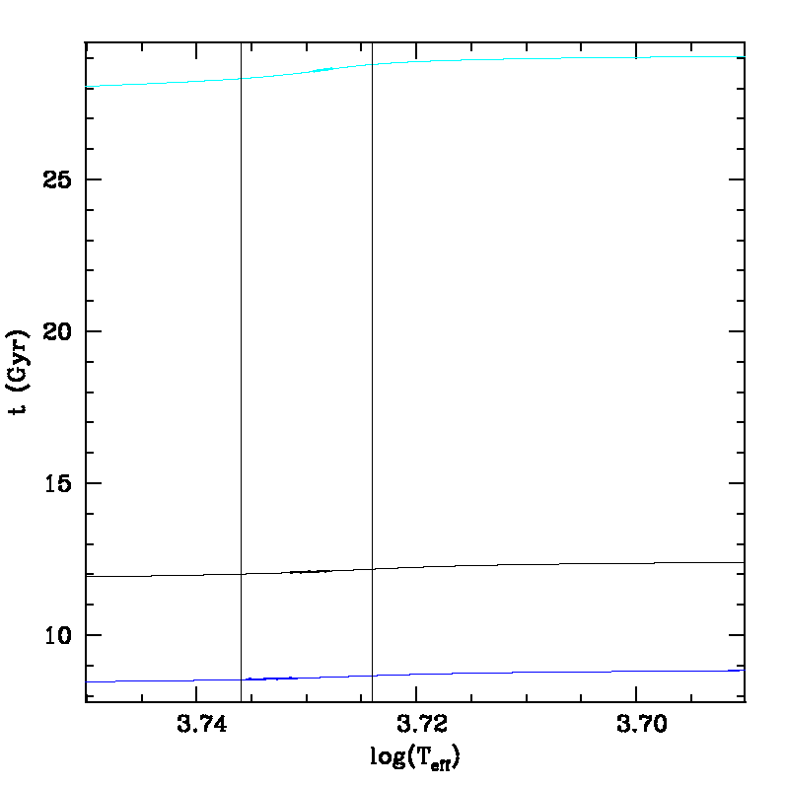
Knowledge of the mass for RGB stars (e.g. from asteroseismology) is crucial for age dating, irrespective of uncertainties of stellar evolution calculations.
We need precision in the order of about 3% to keep the error on RGB ages around 10% (in the low mass star regime)

Slide 10
Different models, different
RGB T_{eff}
3,5,12 Gyr

Slide 11
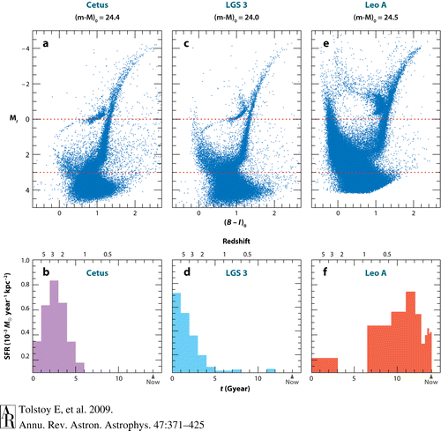
One more step
Morphology plus predicted number of stars along evolutionary phases
SFH of Resolved galaxies

Slide 12
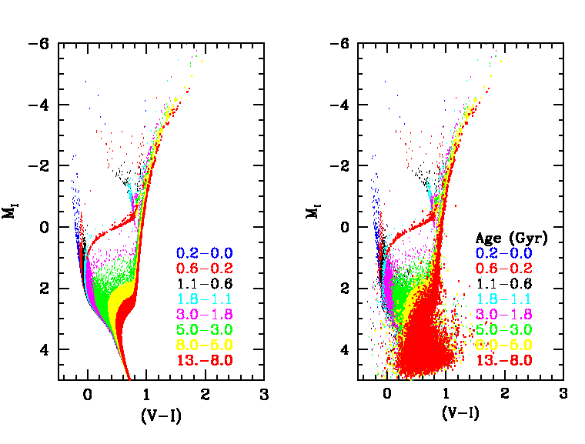
without photometric error
with photometric error

Slide 13
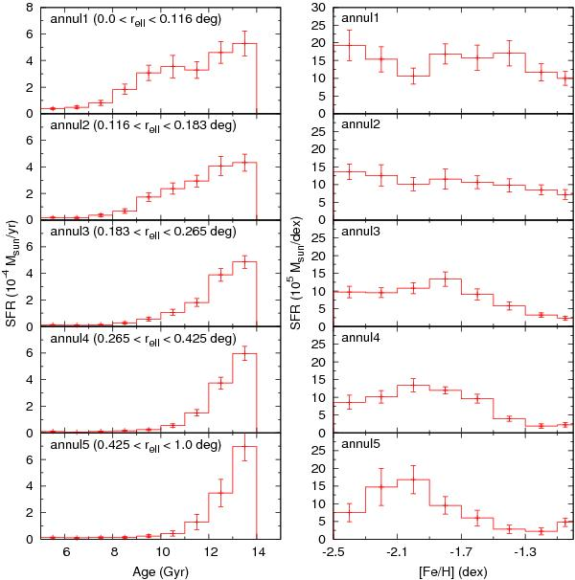
SFH derived by
from de Boer et al. (2012)

Slide 14
Coimbra experiment
7 groups derived the SFH of an LMC field using their own techniques
Skillman et al. (2001)

Slide 15
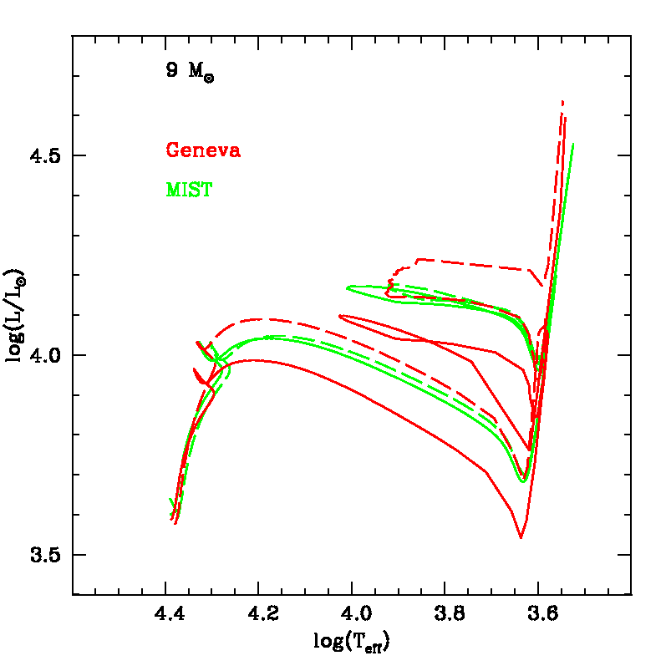
Very different results with different implementations of rotational mixing and angular momentum transport
ssolar
Rotating models (dashed lines)
Non-rotating models (solid lines)
MIST
Geneva

Slide 16
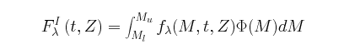
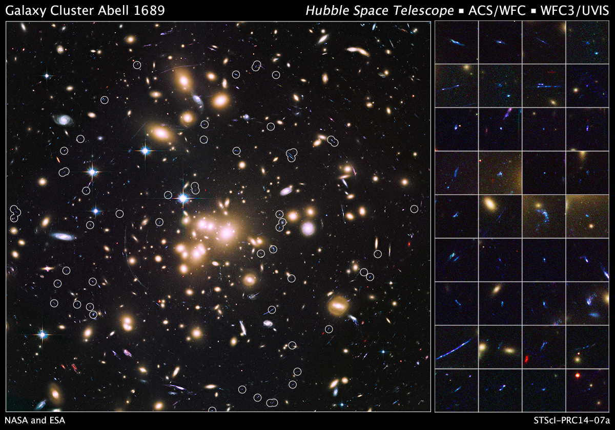
Up to another level
Studying
unresolved systems
Flux of individual stars
IMF

Slide 17
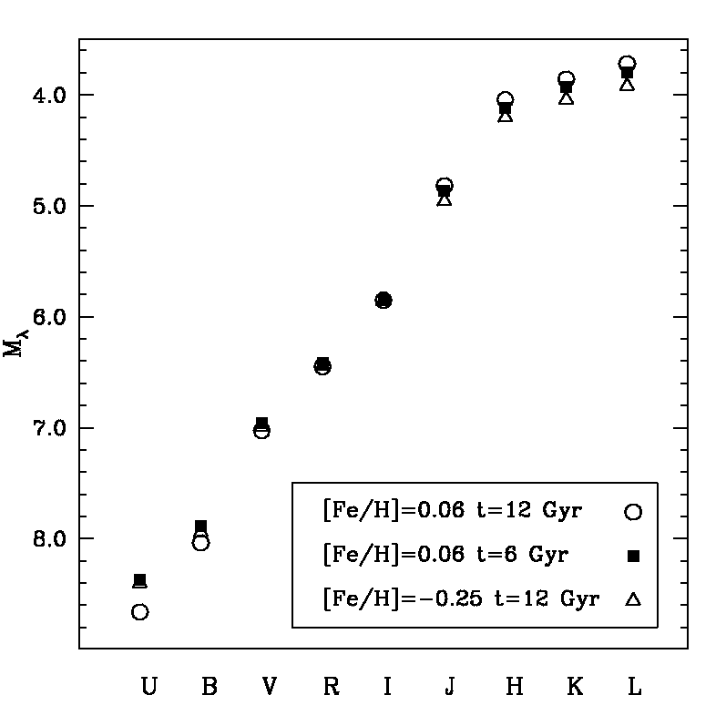
Integrated broadband magnitudes
low-resolution SED
We need to use jointly blue-visible and near-IR magnitudes to minimize the age-metallicity degeneracy

Slide 18
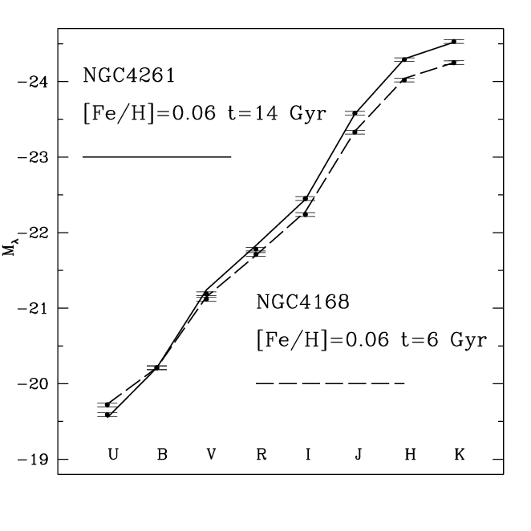
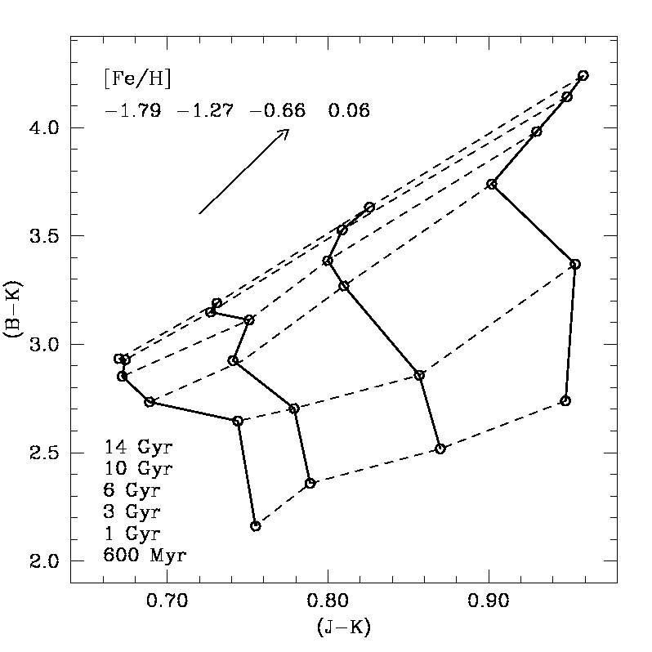
low-resolution SED fitting
colour-colour diagrams

Slide 19
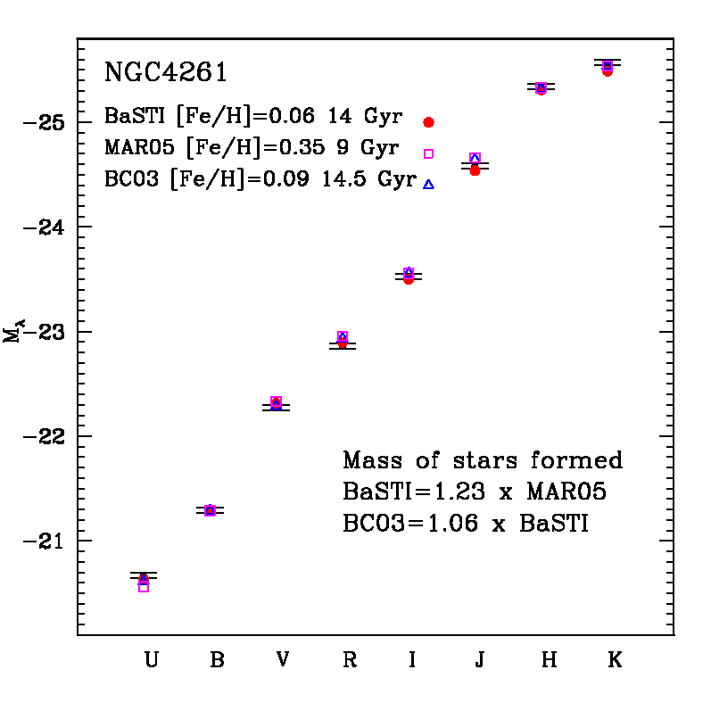
Different authors, different ages/mass of stars formed

Slide 20
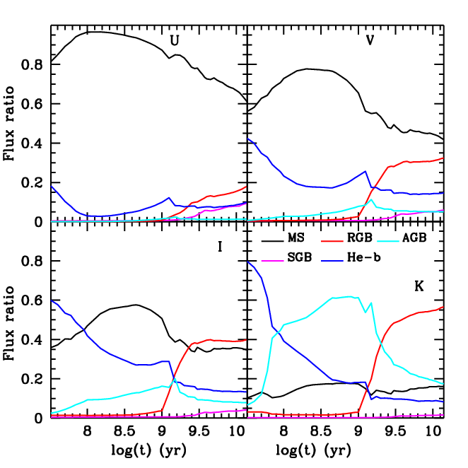

Slide 21
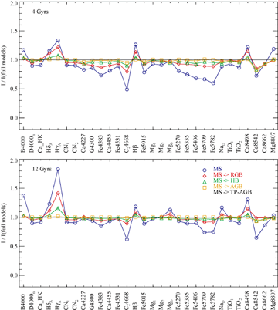
Absorption feature indices
Coelho et al. (2007)

Slide 23
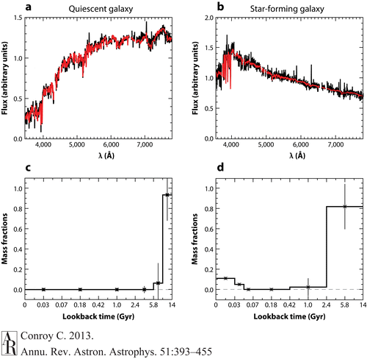
Full spectrum fitting

Slide 24
Consistency of full spectrum-fitting results on one galaxy
Baldwin et al. (2018)

Slide 25
Mass-weighted mean ages for a sample of galaxies
Mass-weighted mean ages derived from optical (top) and NIR (bottom) spectroscopy for the various models plotted against the ages derived by V16

Slide 26
IN A NUTSHELL
We still need to be very cautious when interpreting our results
Asteroseismology can really help us, at least for the parameter space sampled by the current data

